Slide 1
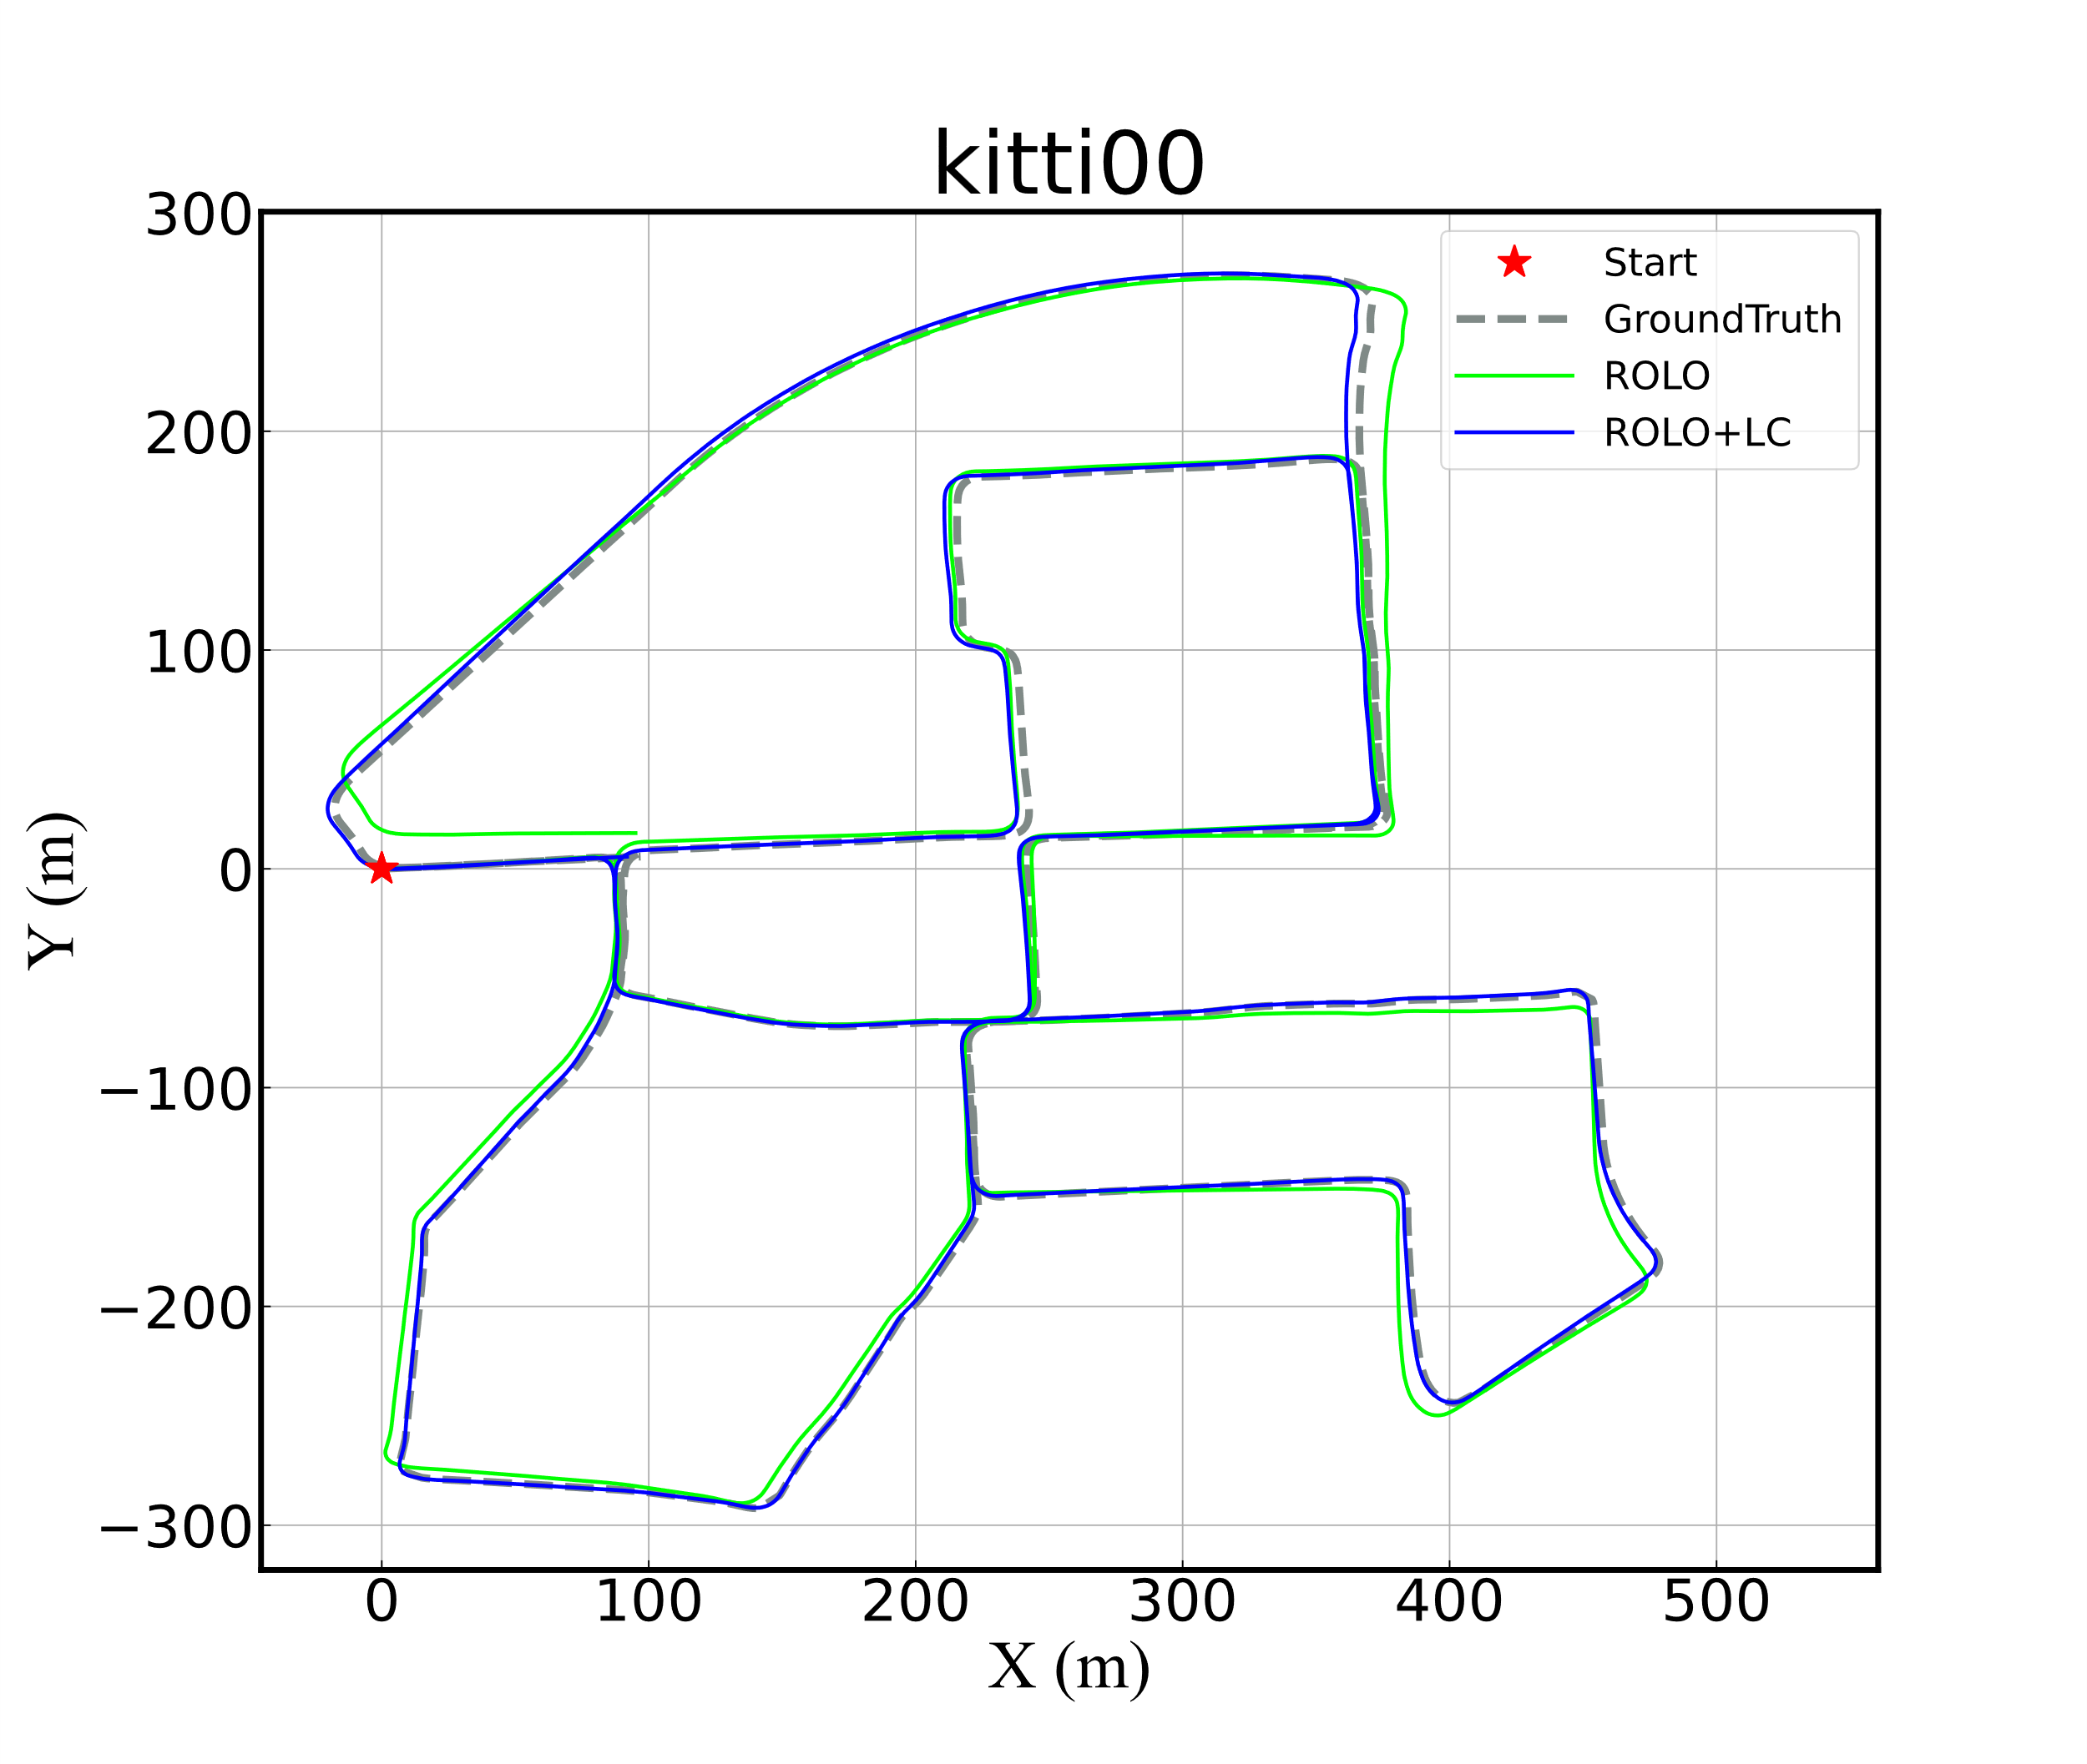
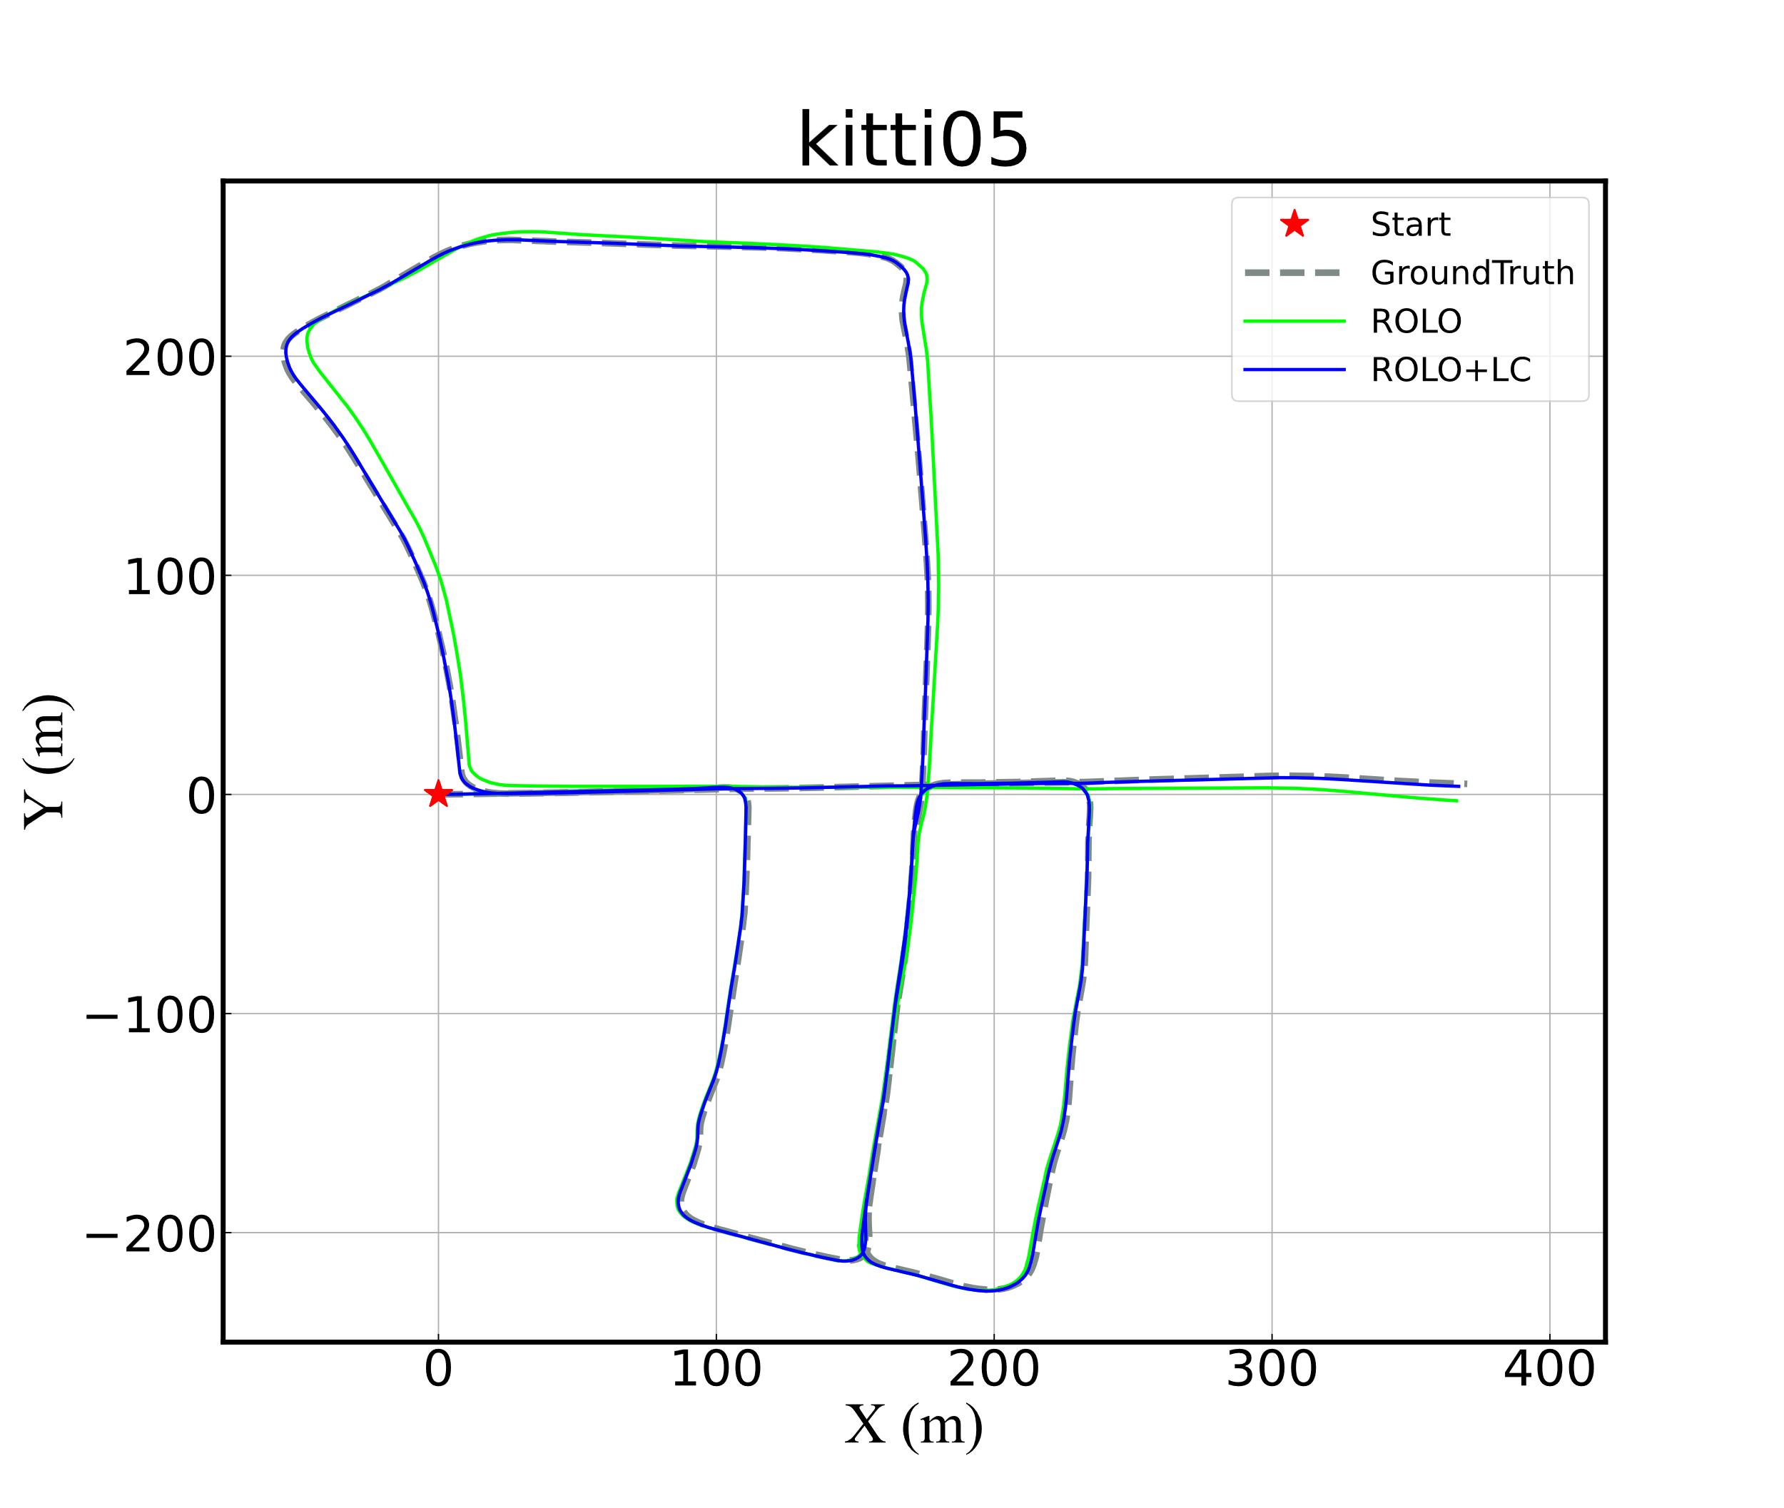
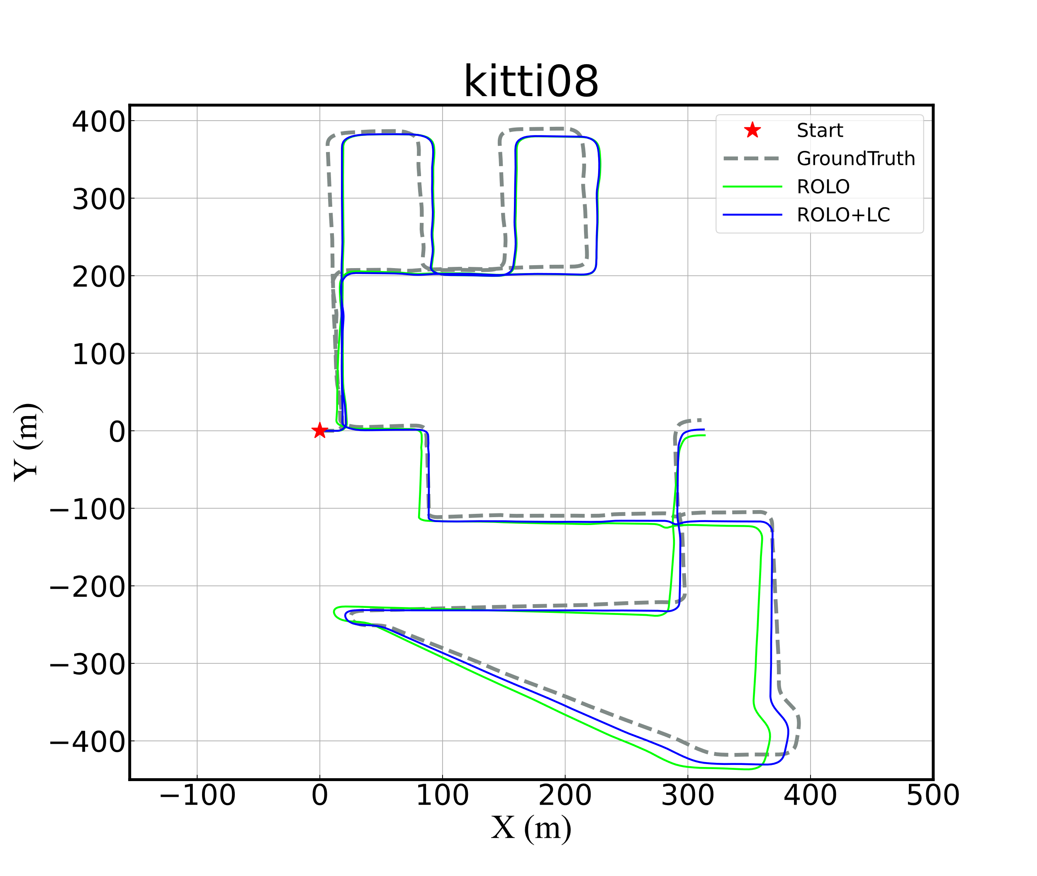
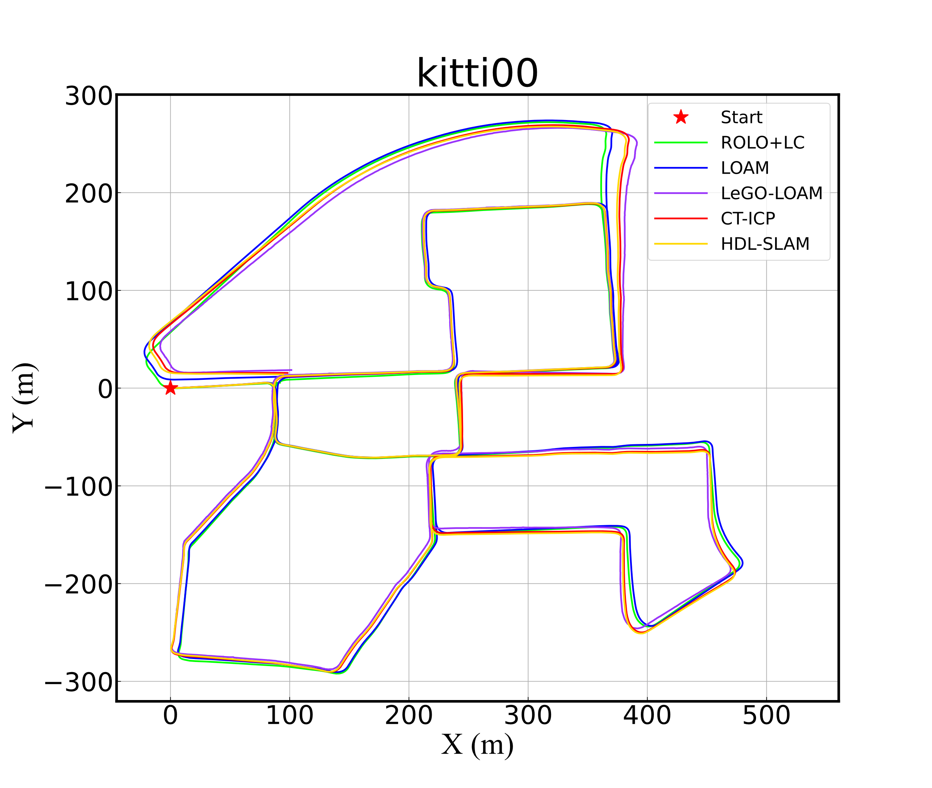
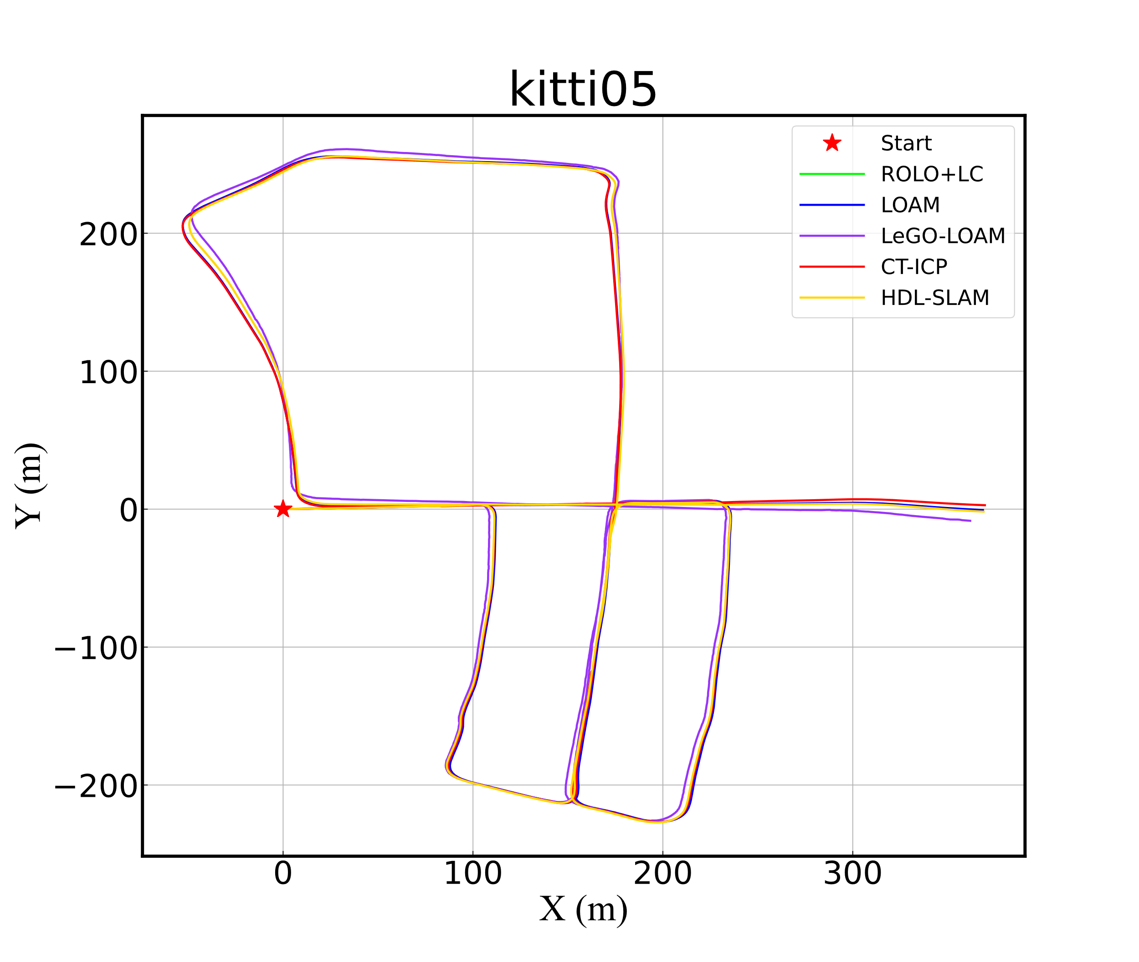
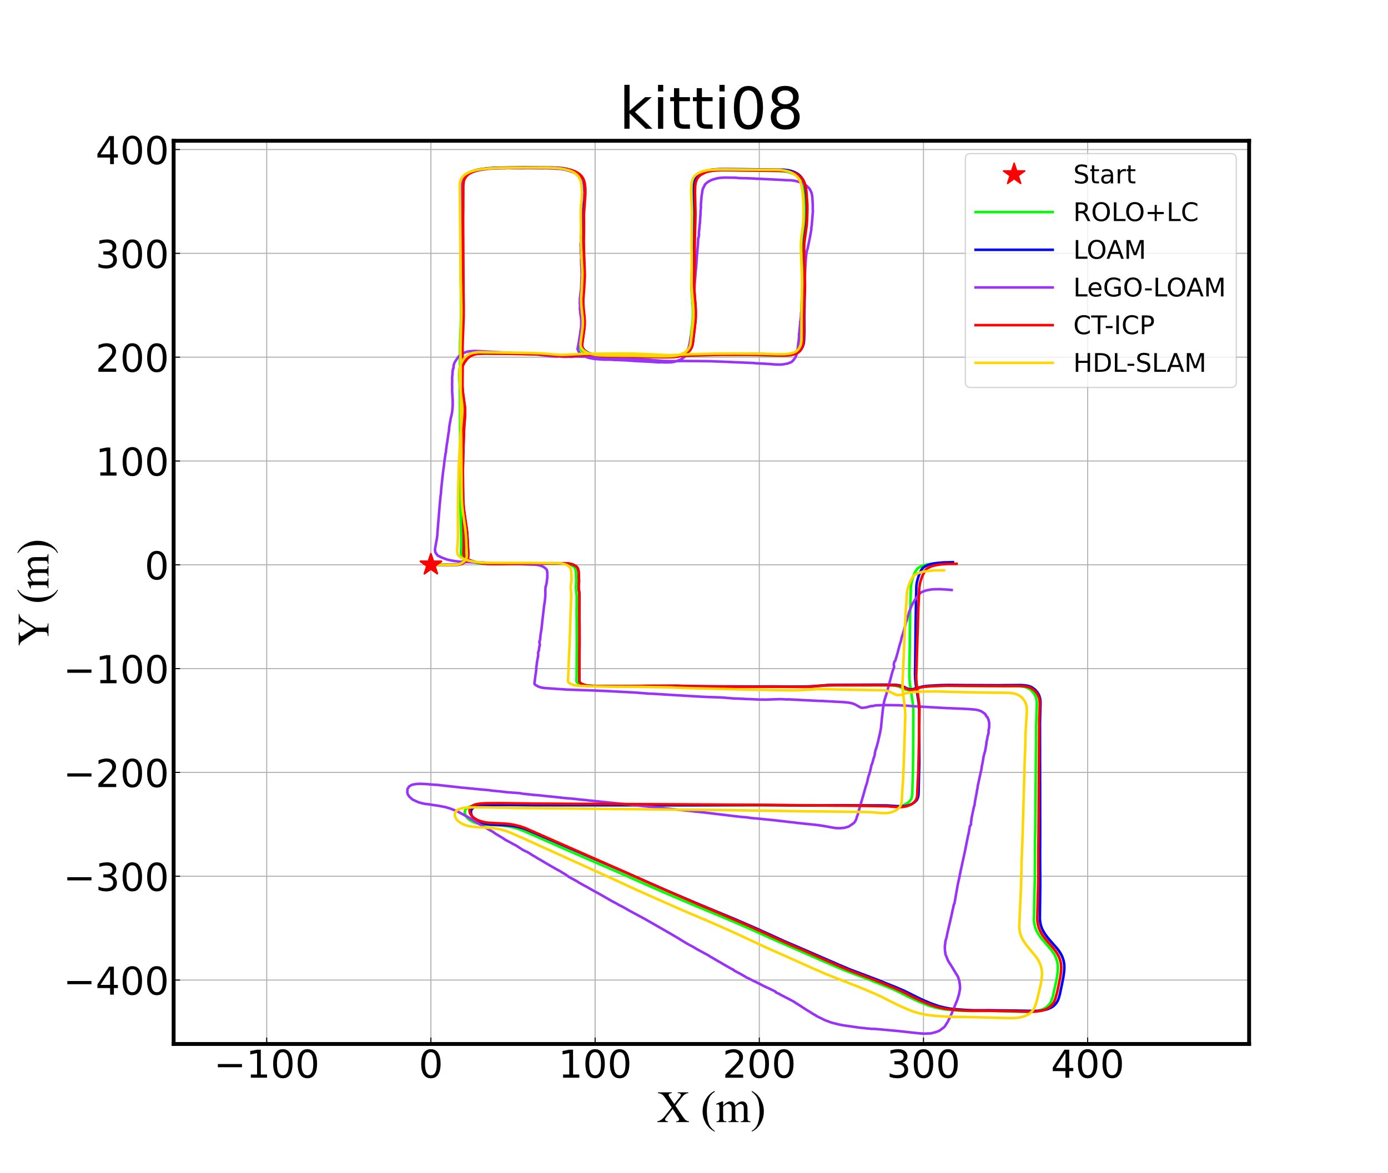
（a）
（c）
（e）
（b）
（d）
（f）

Slide 2
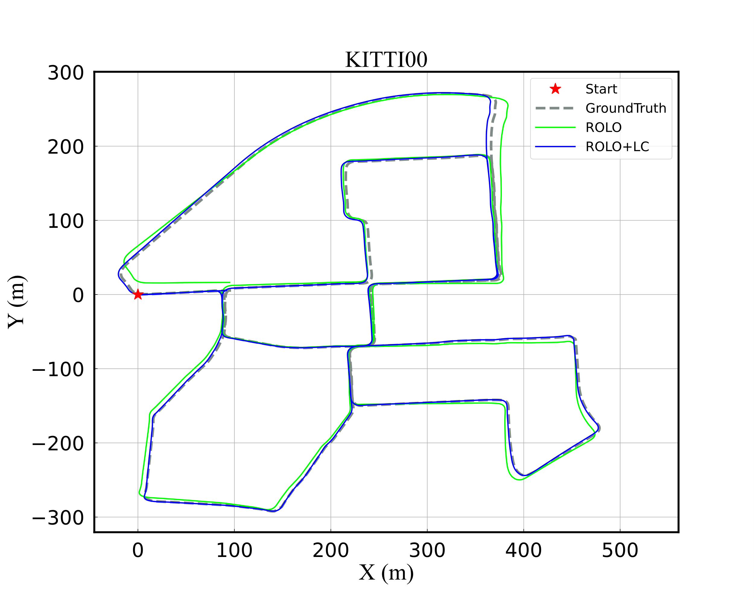
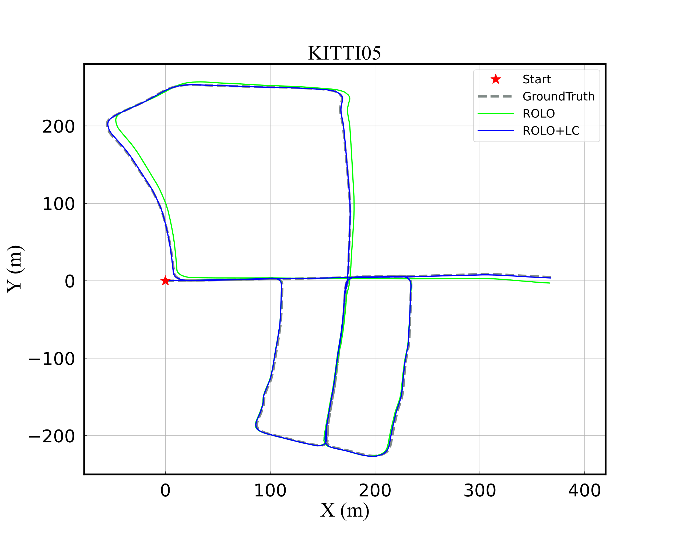
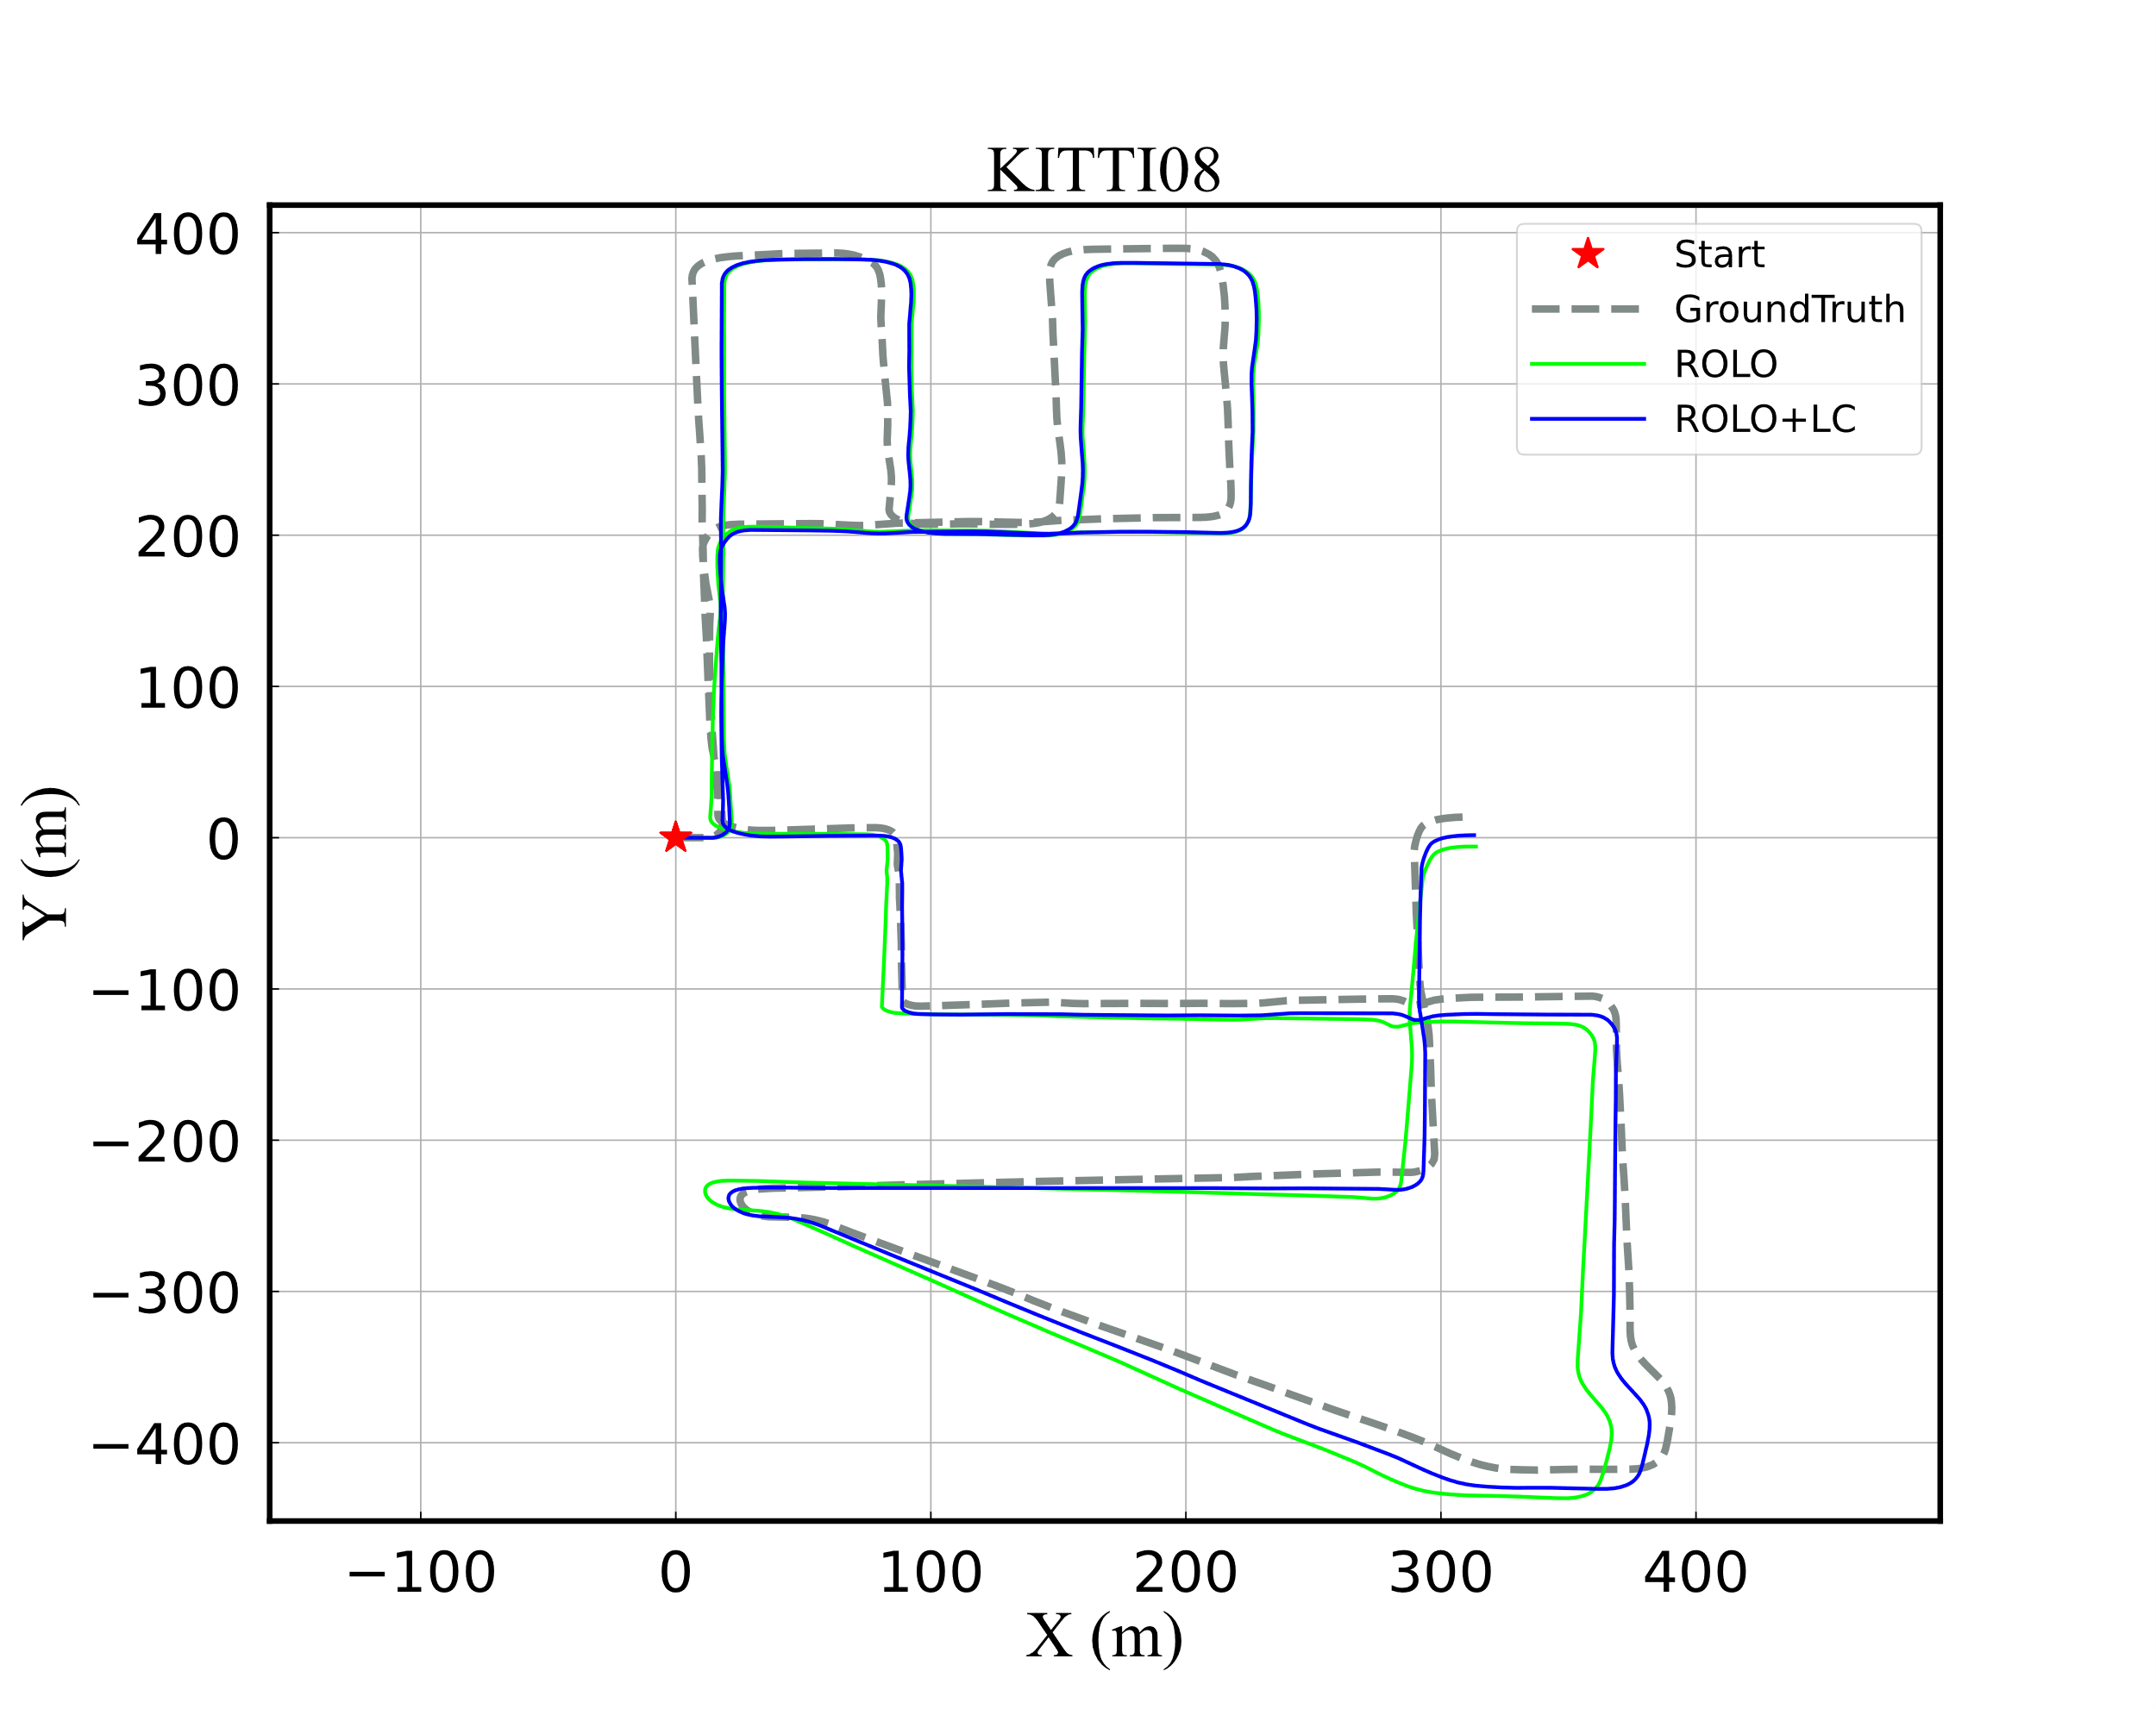
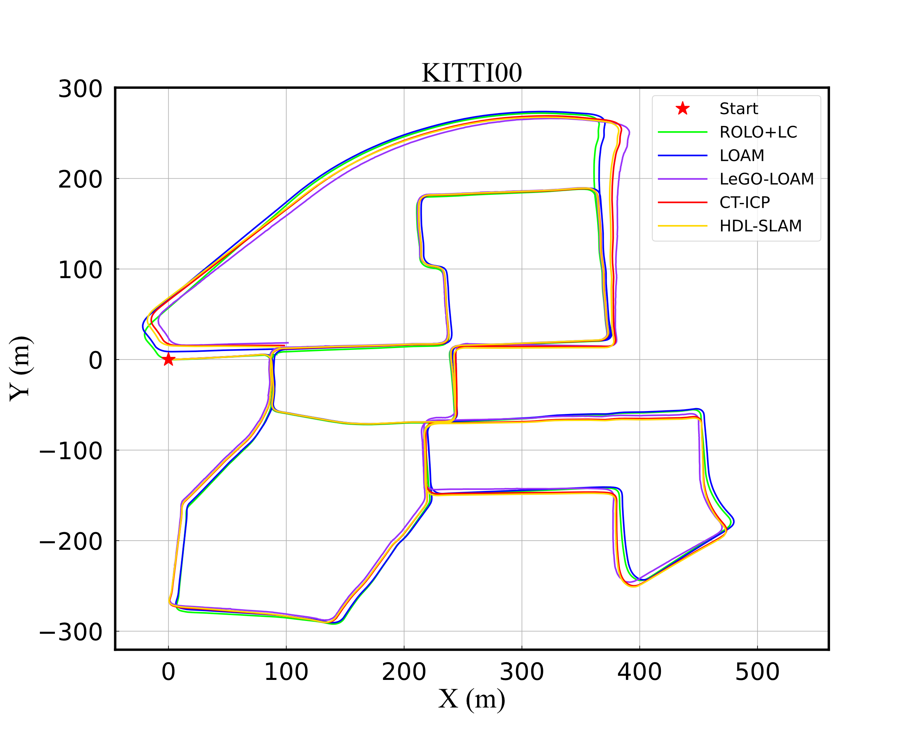
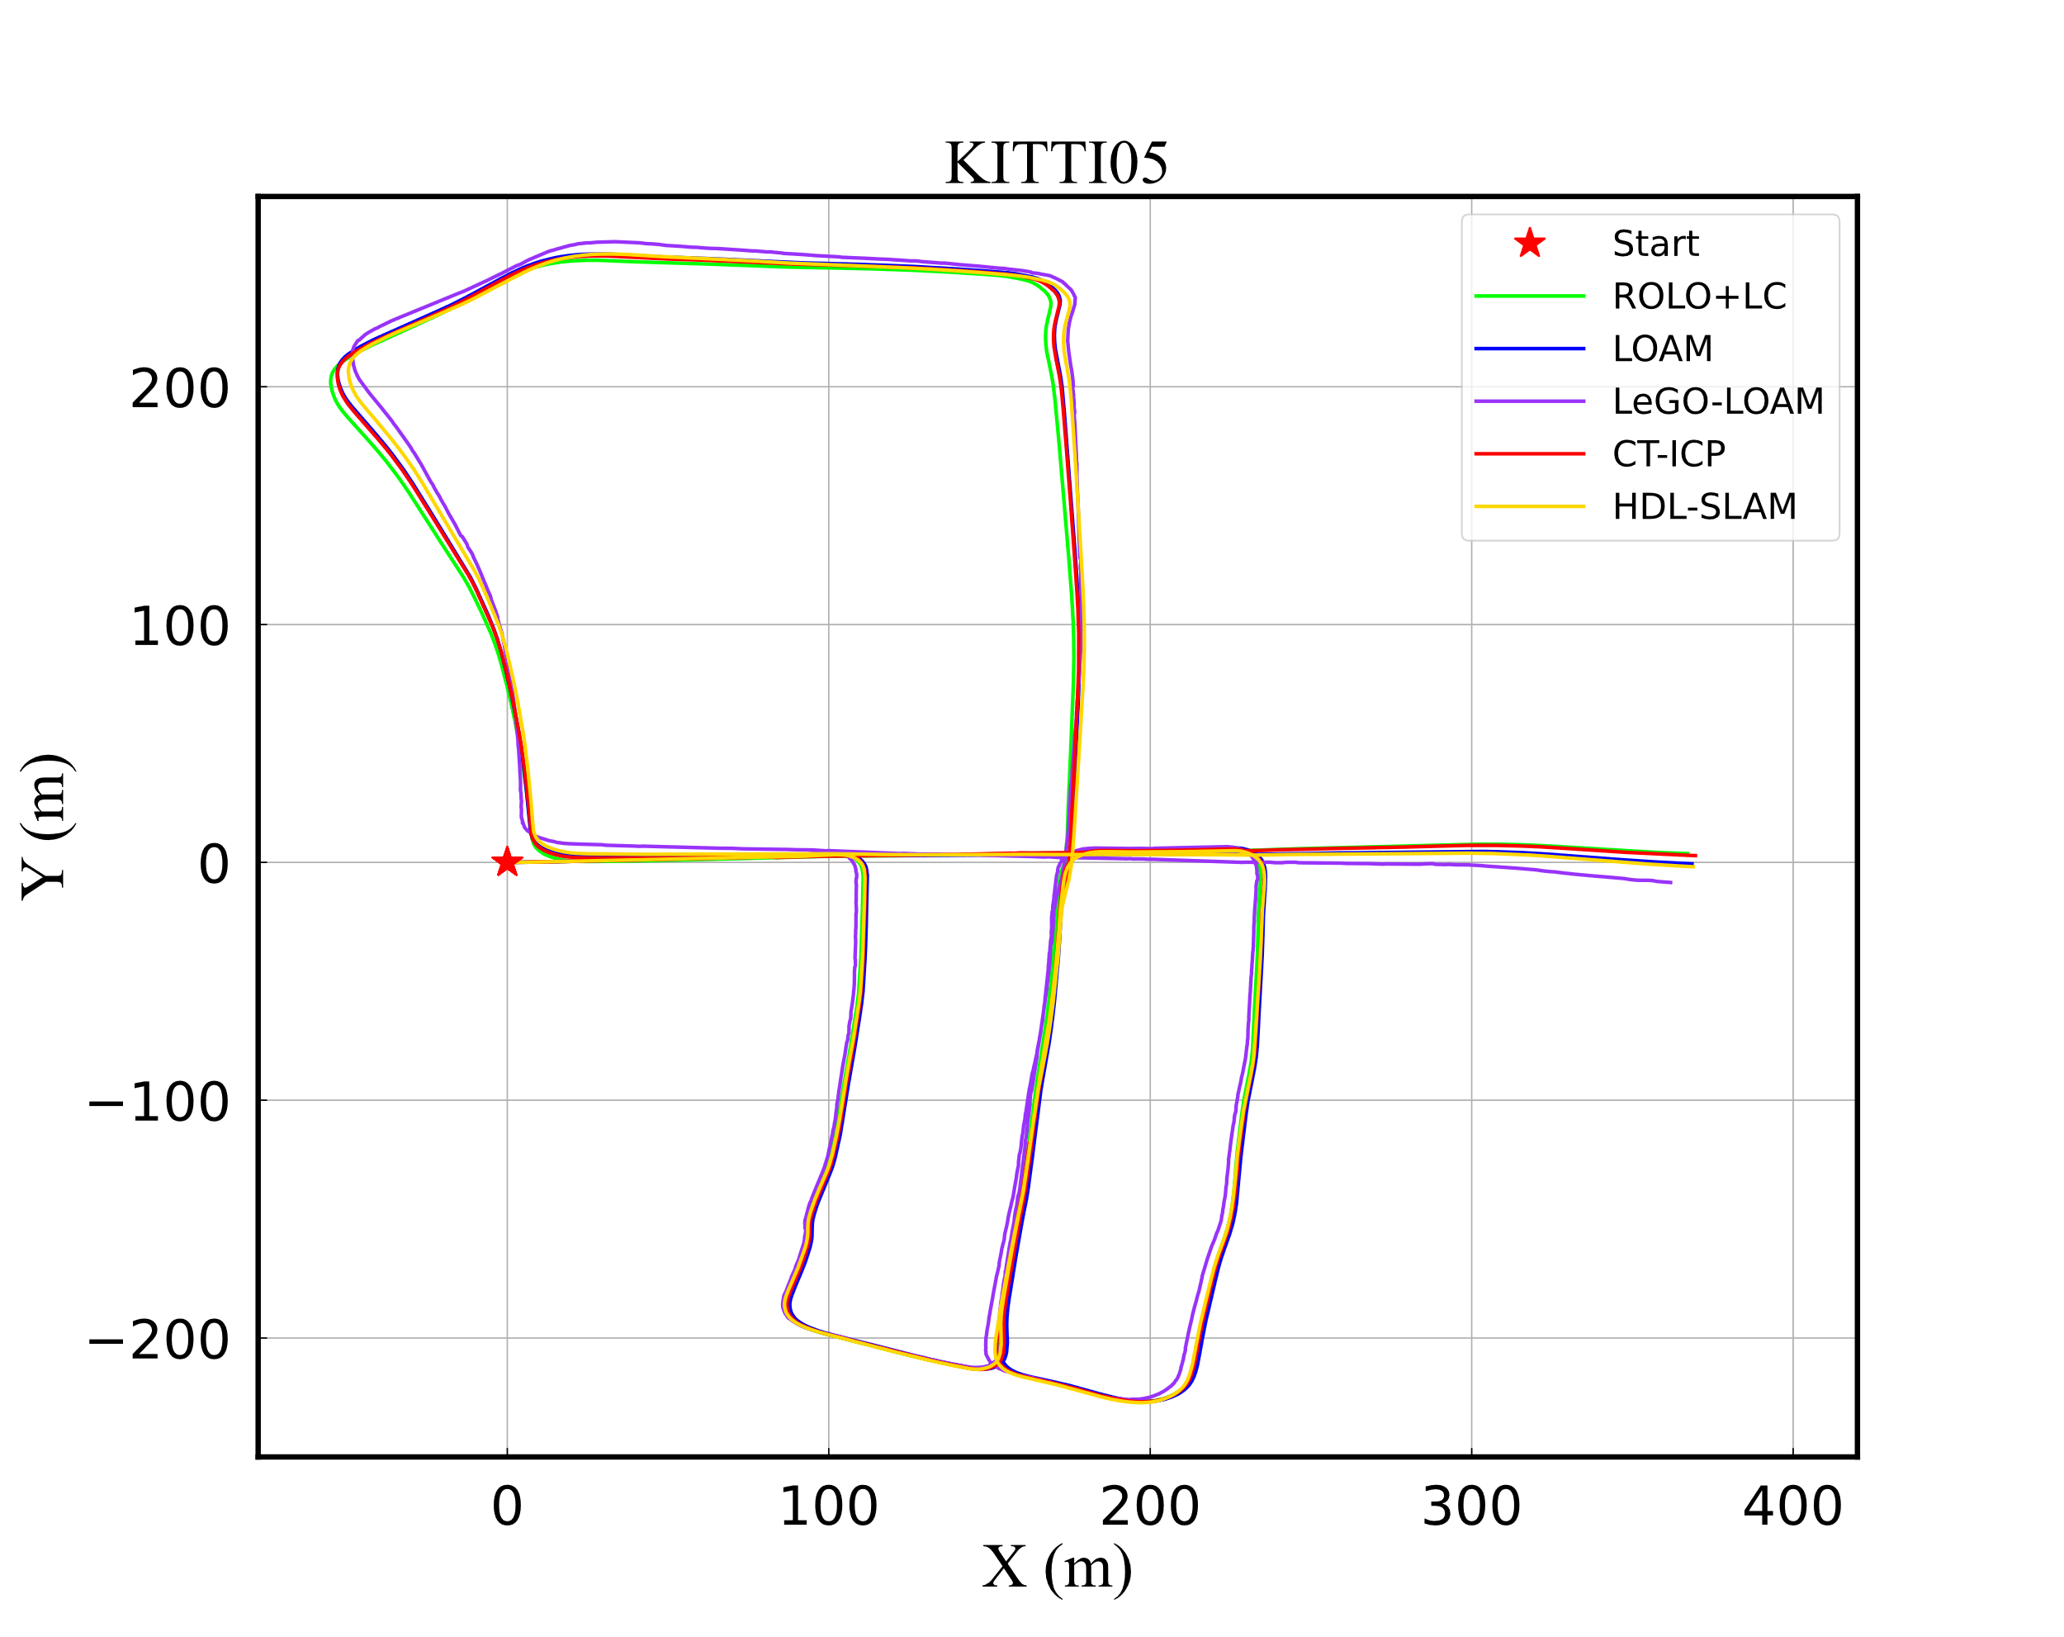

（a）
（c）
（e）
（b）
（d）
（f）

Slide 3
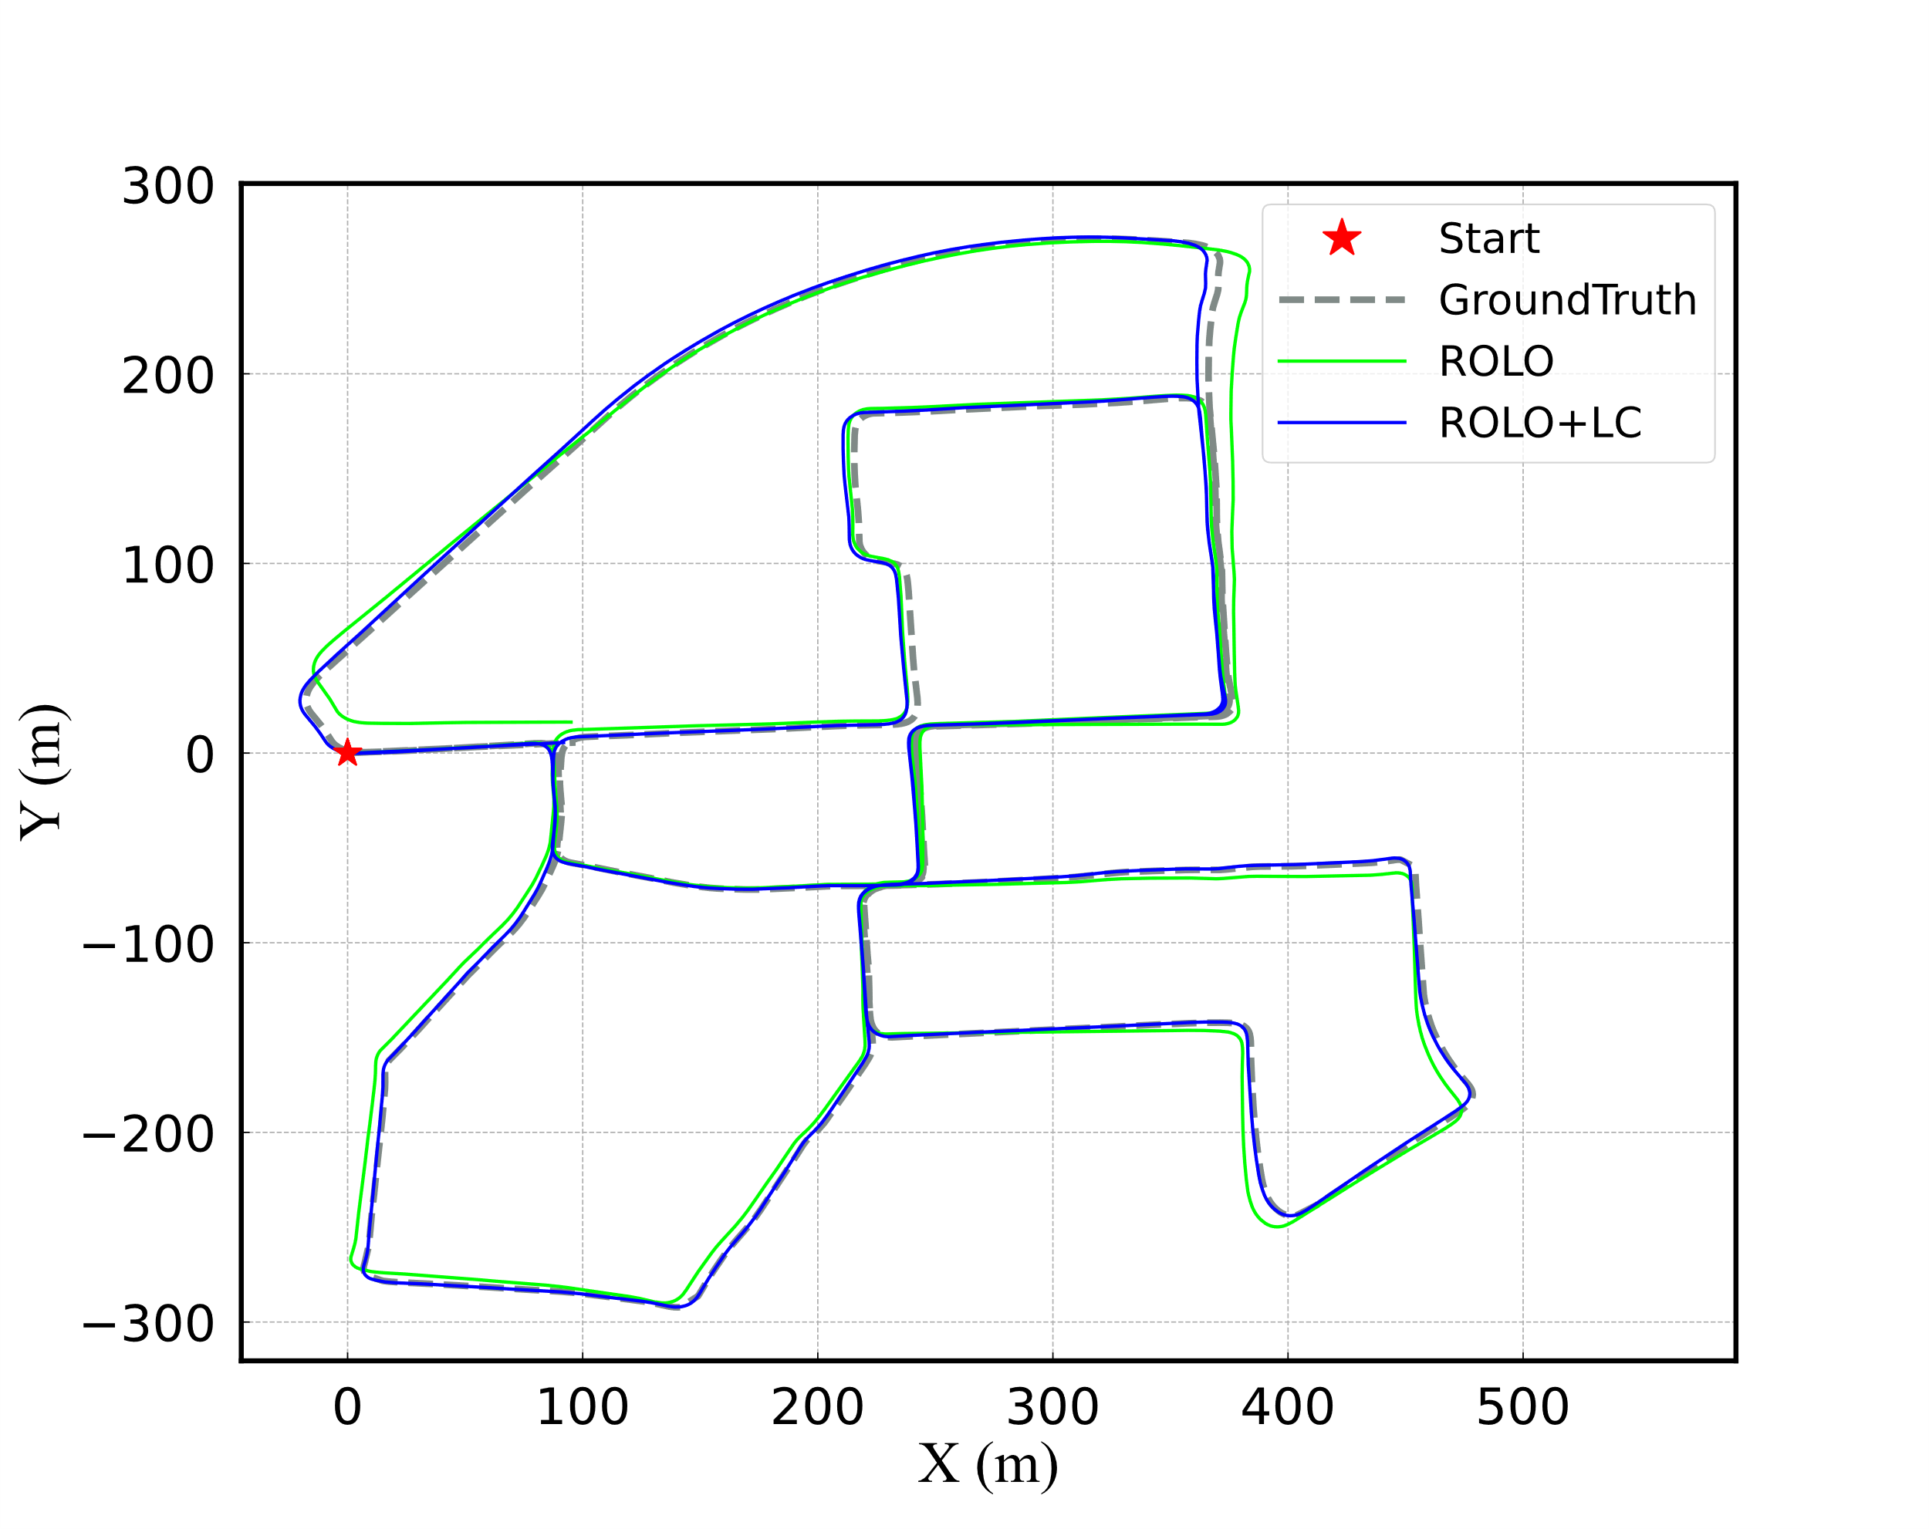
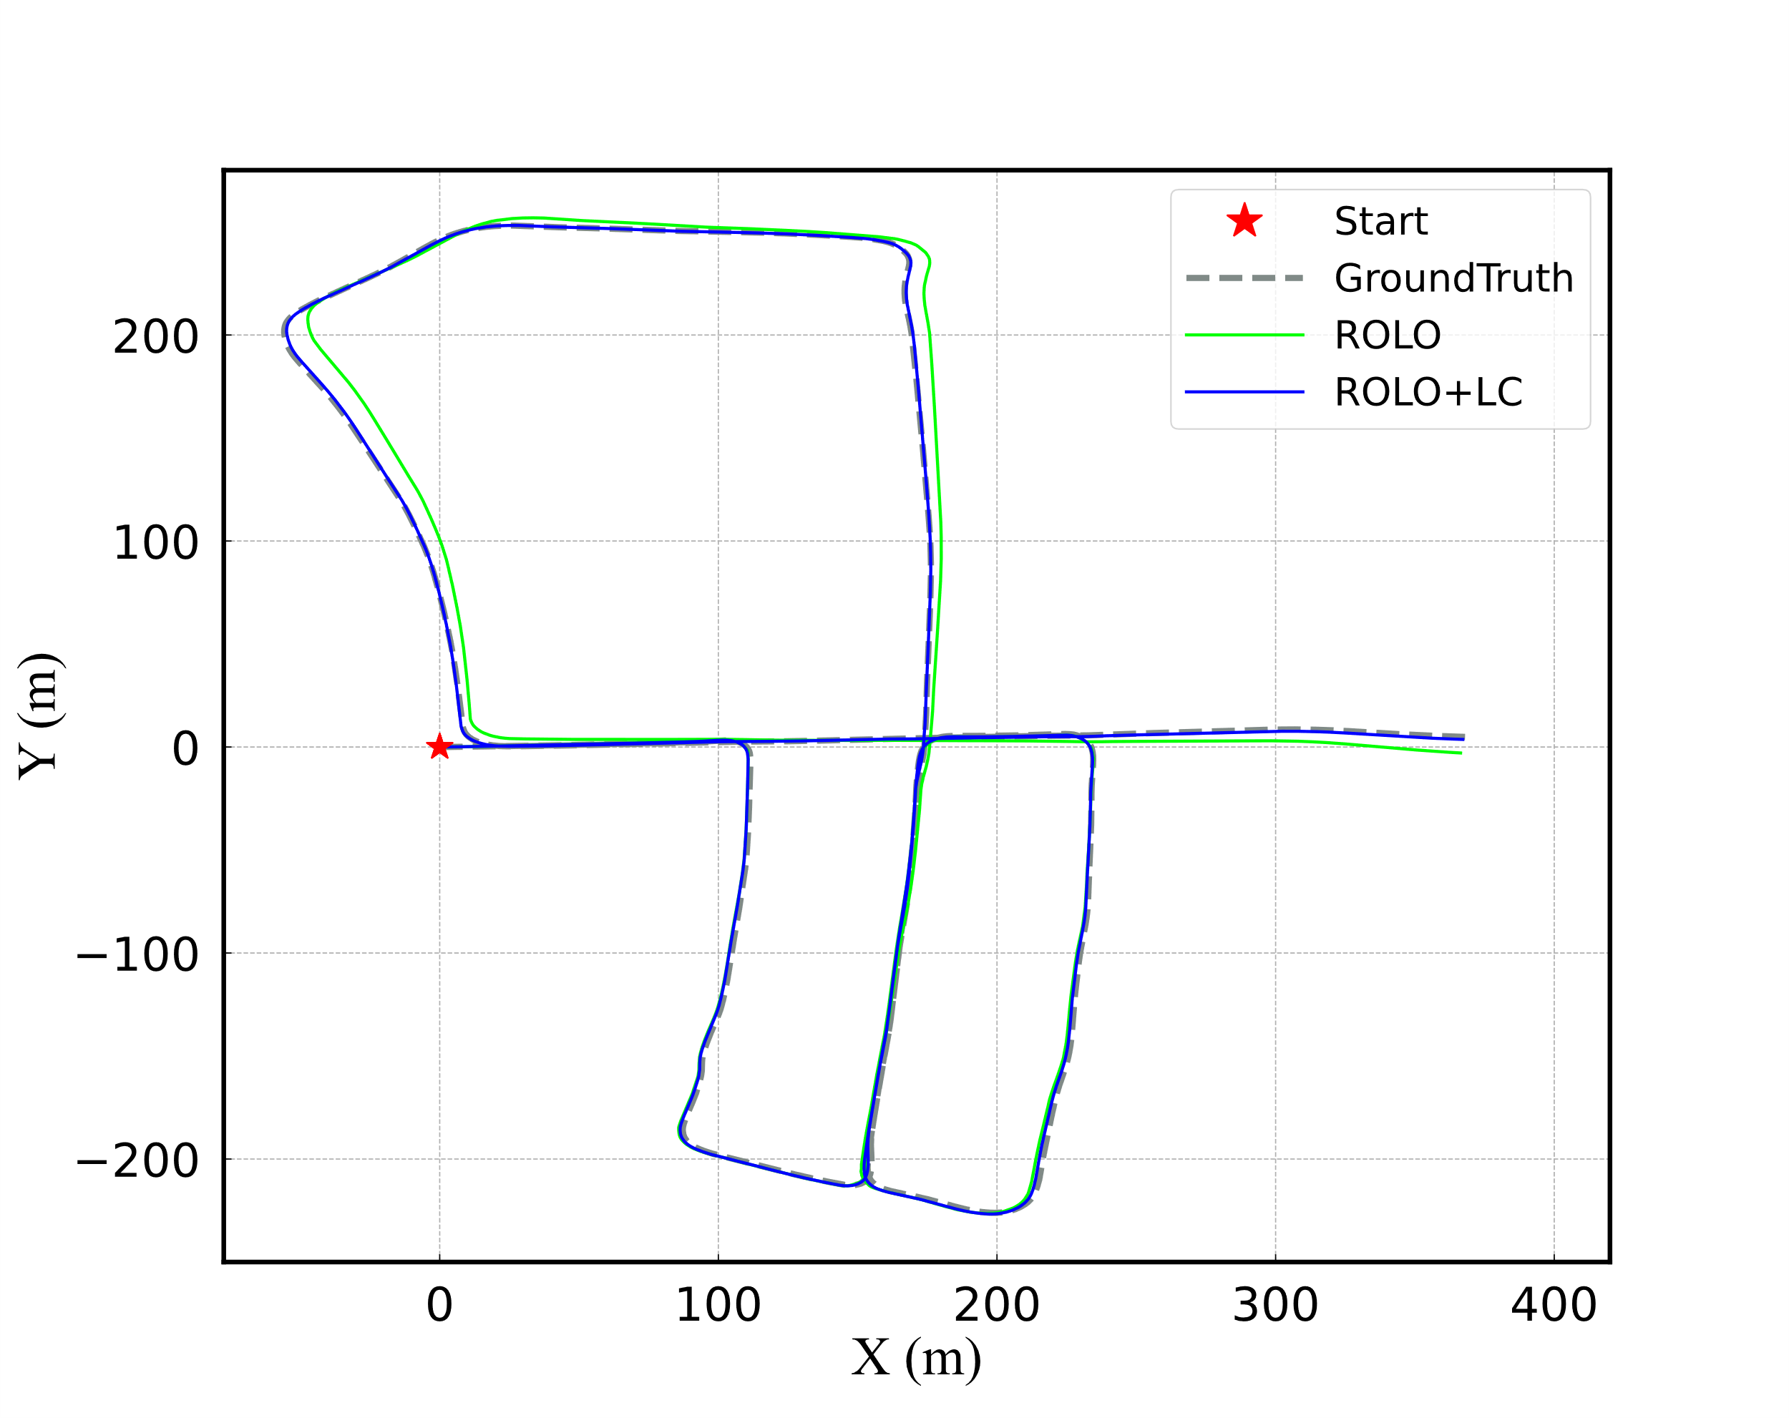
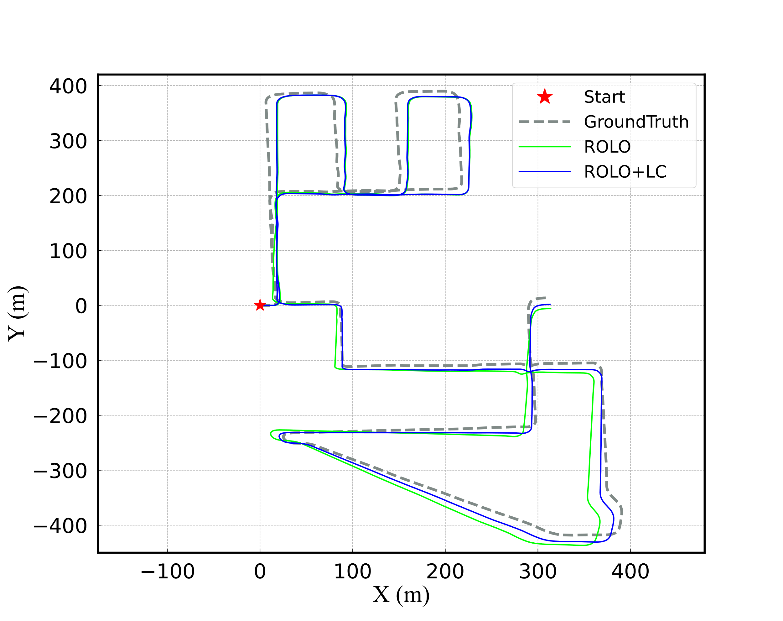
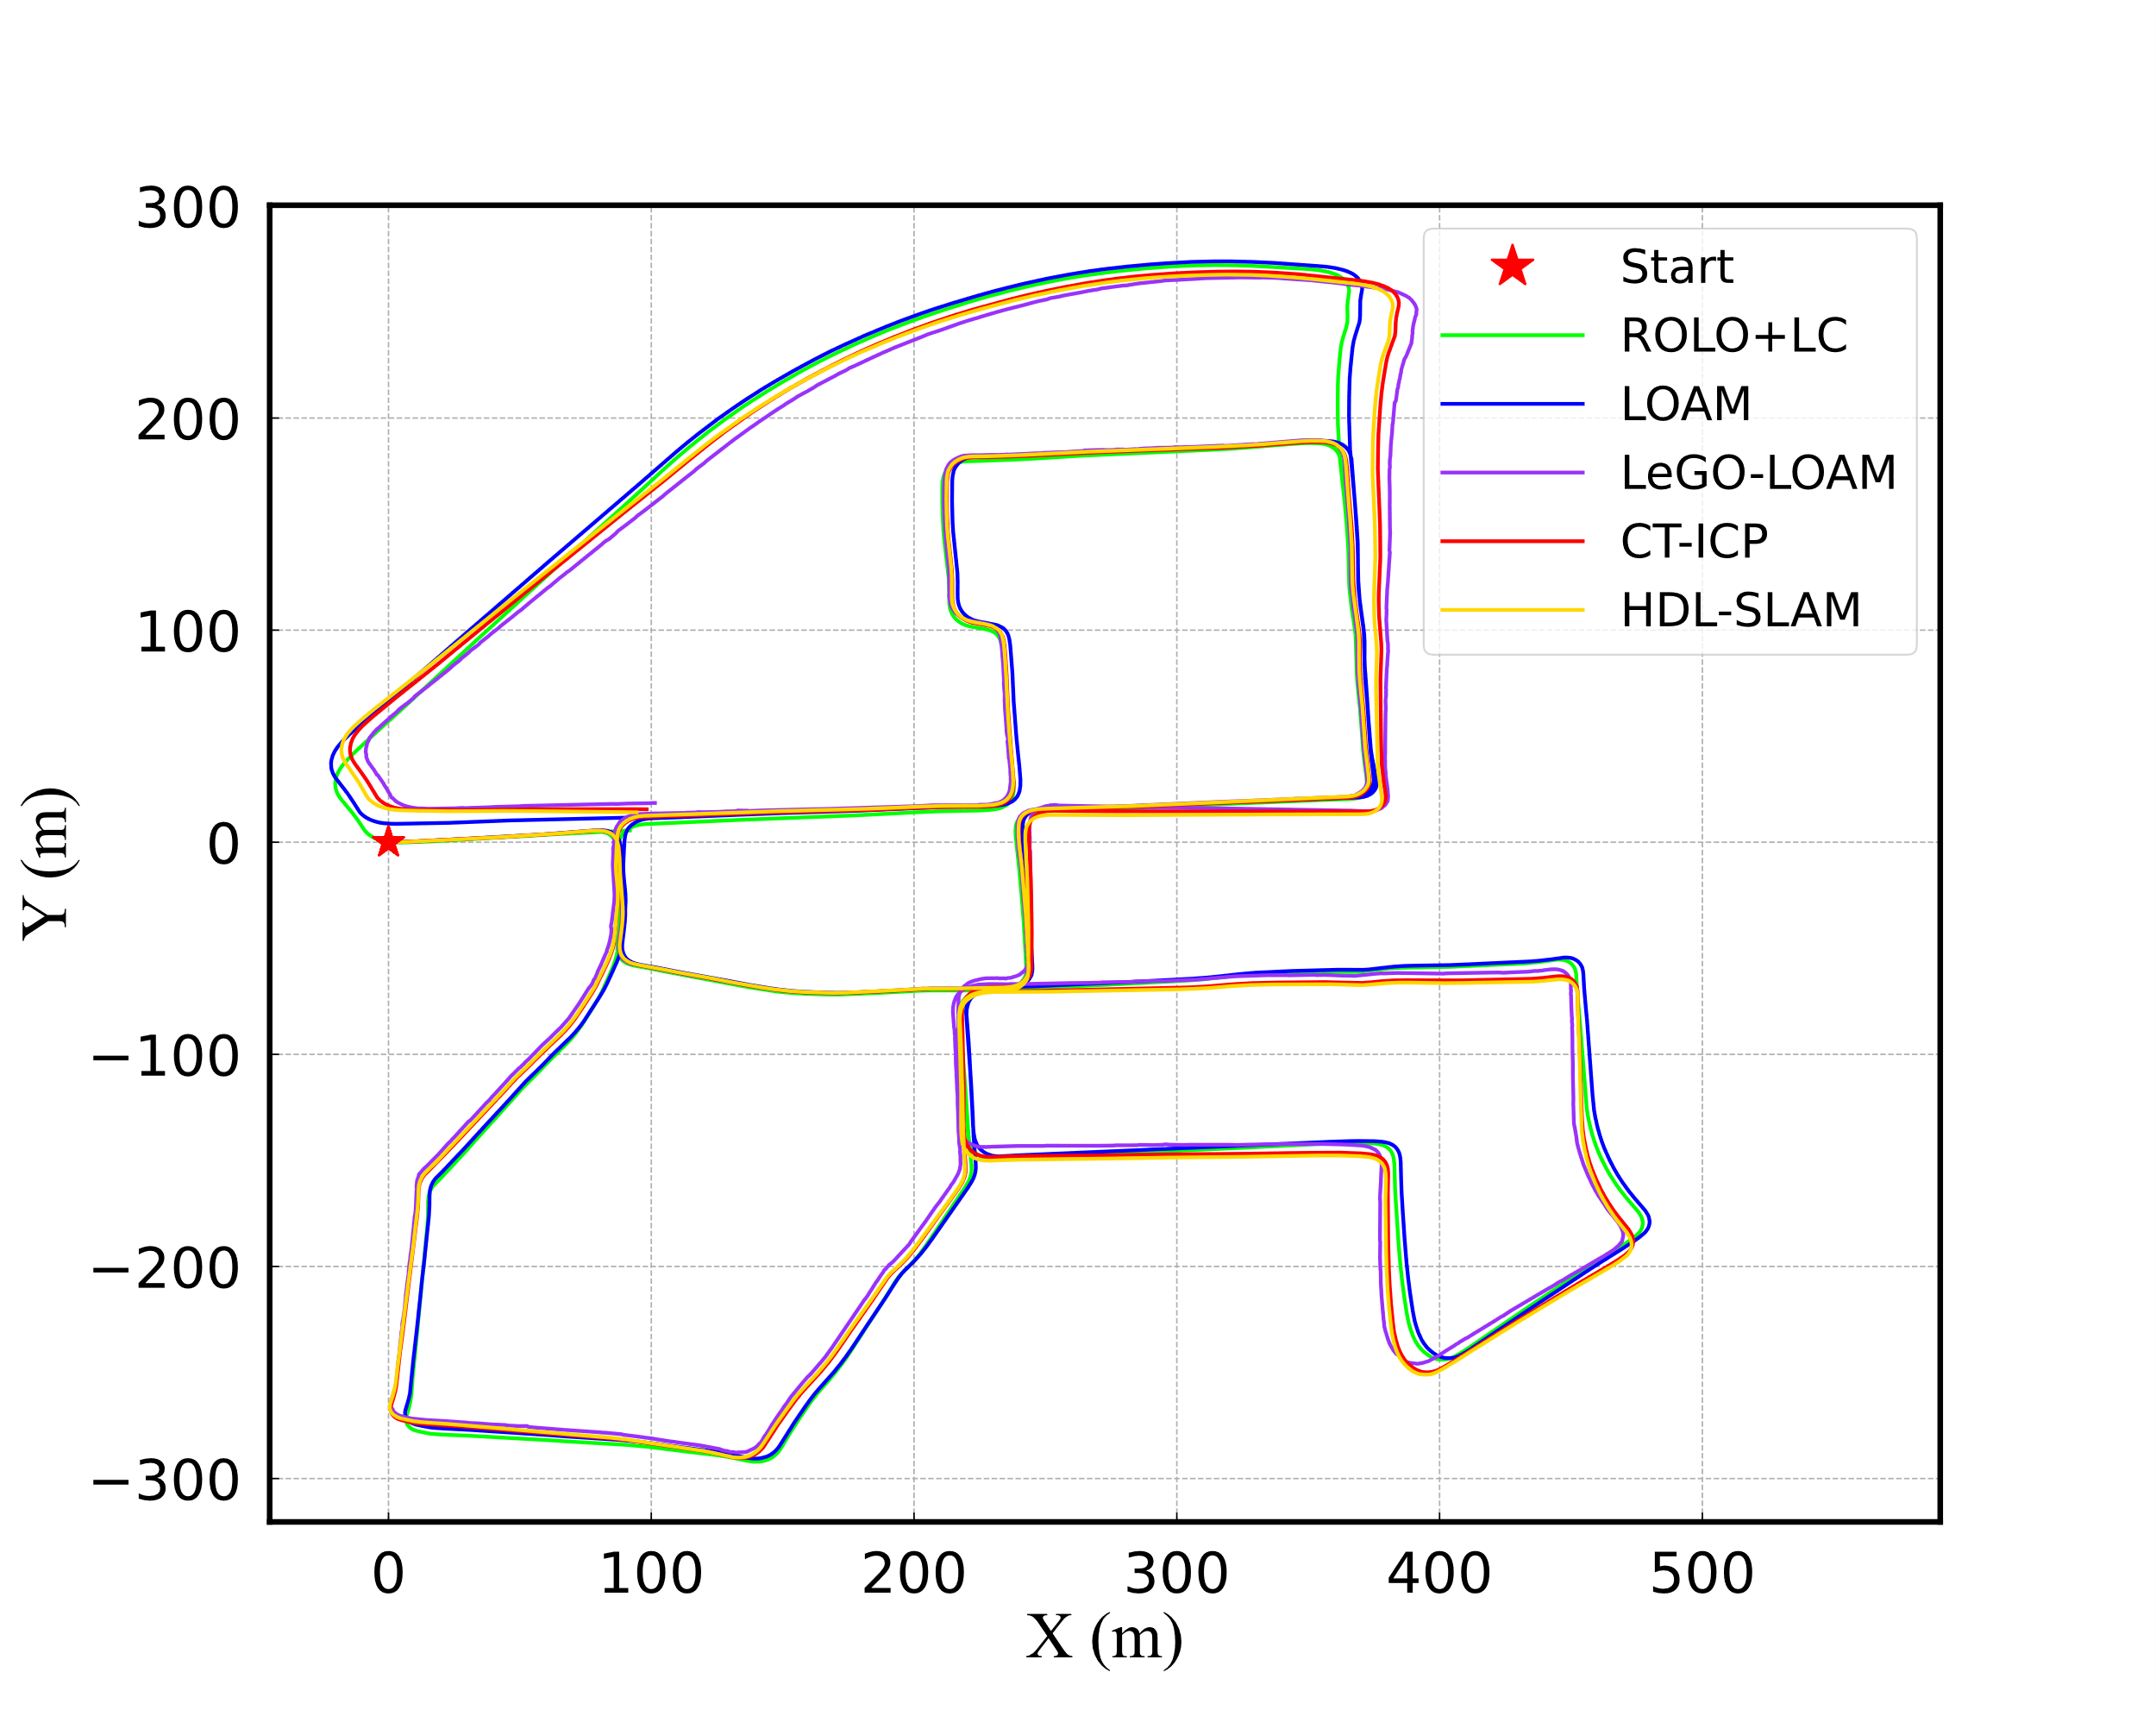
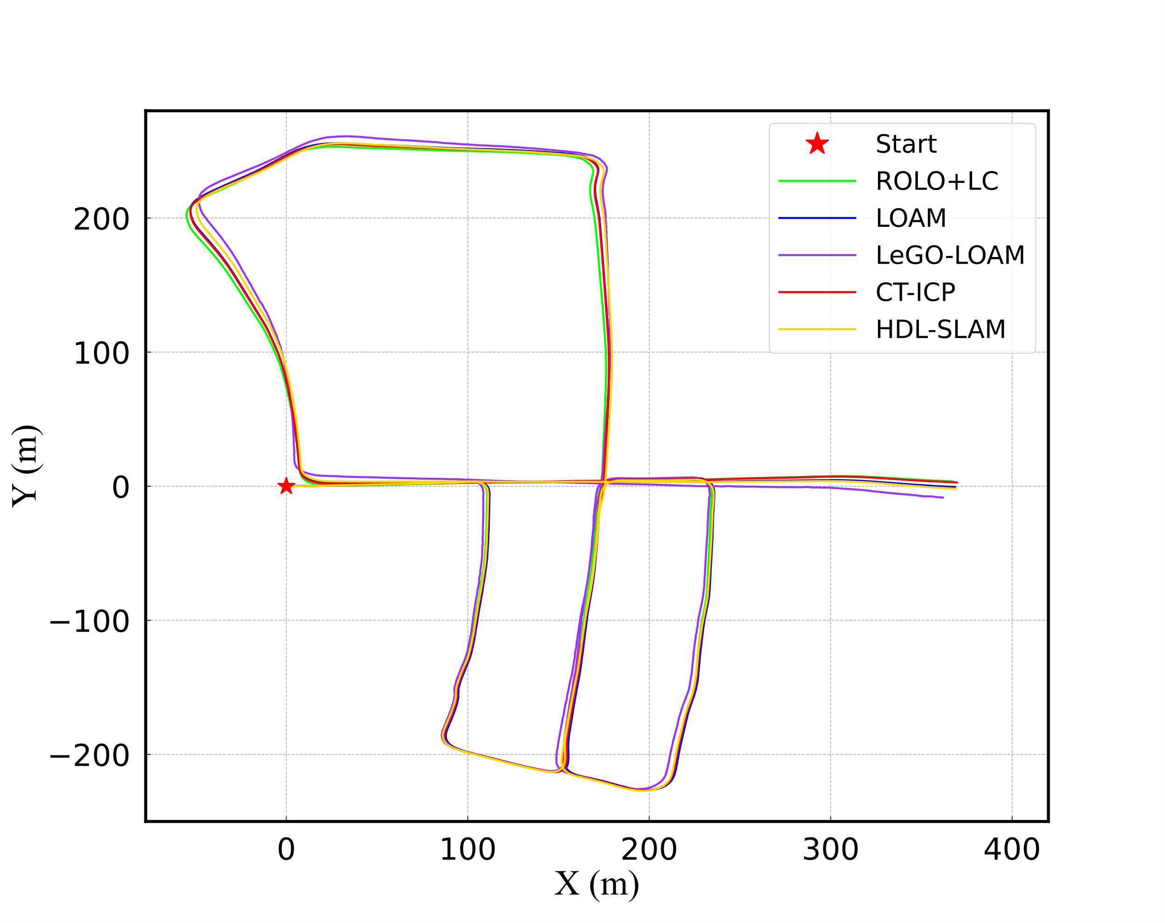
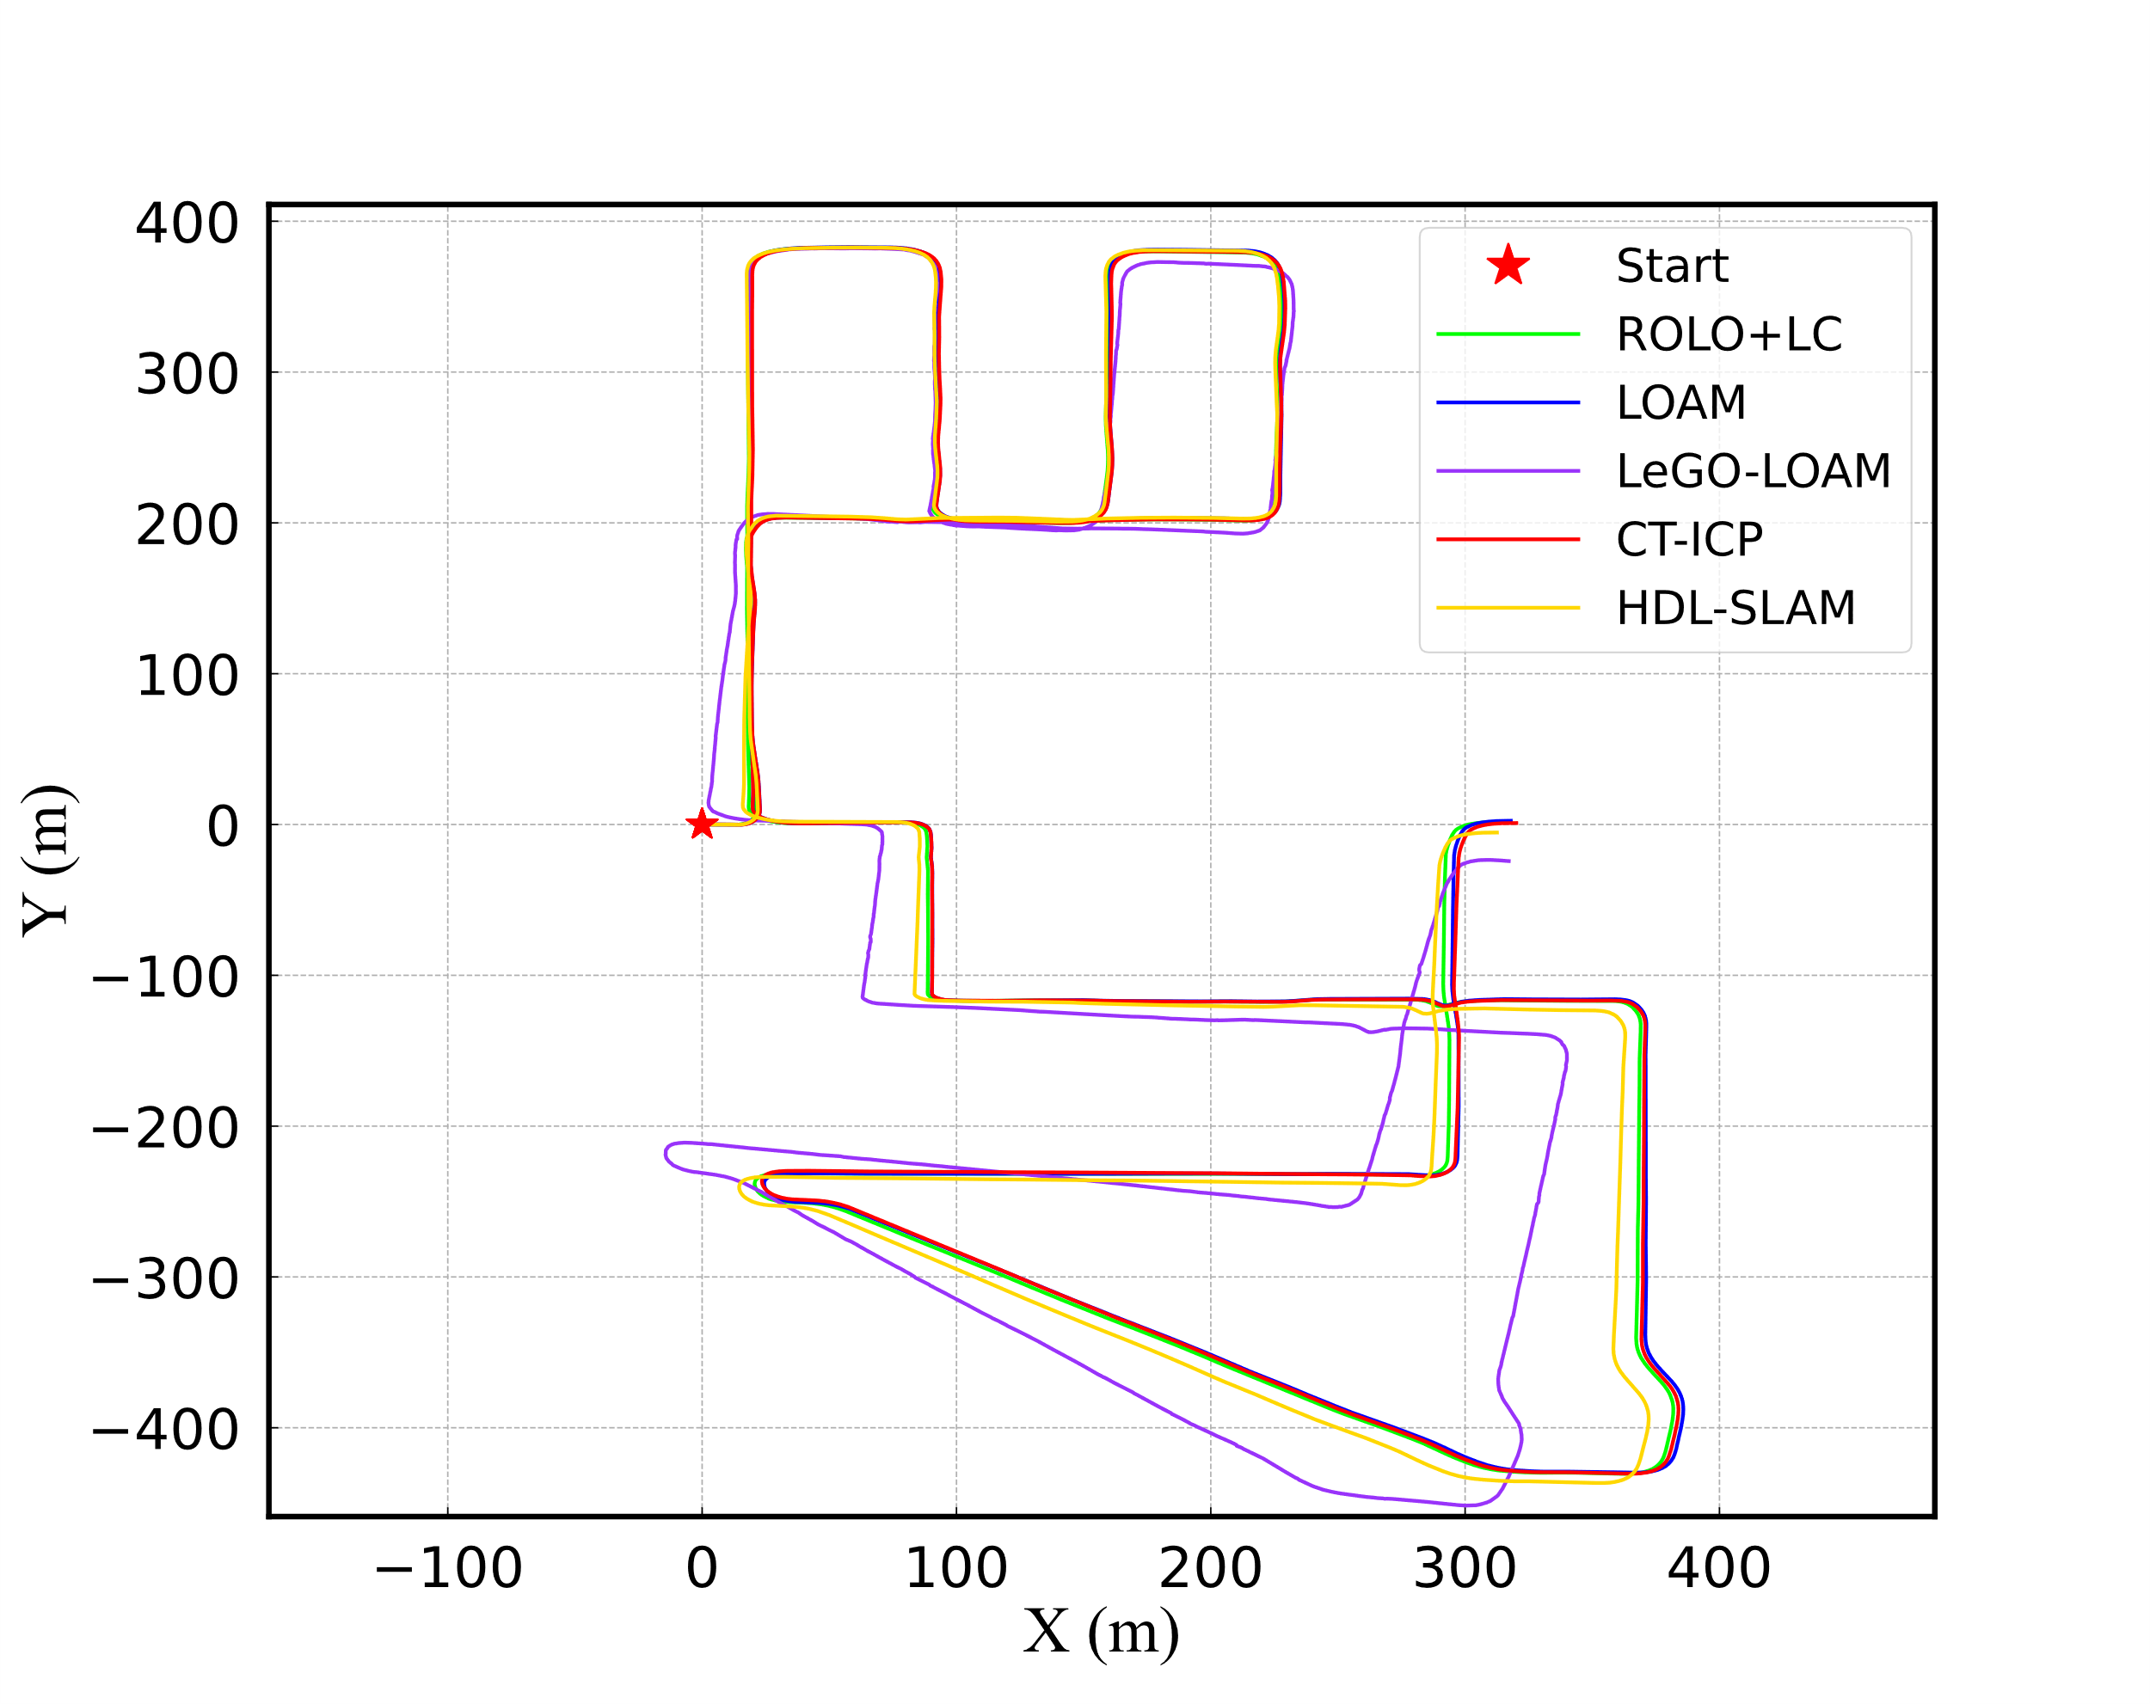
(a) KITTI00
(c) KITTI05
(e) KITTI08
(b) KITTI00
(d) KITTI05
(f) KITTI08

Slide 4
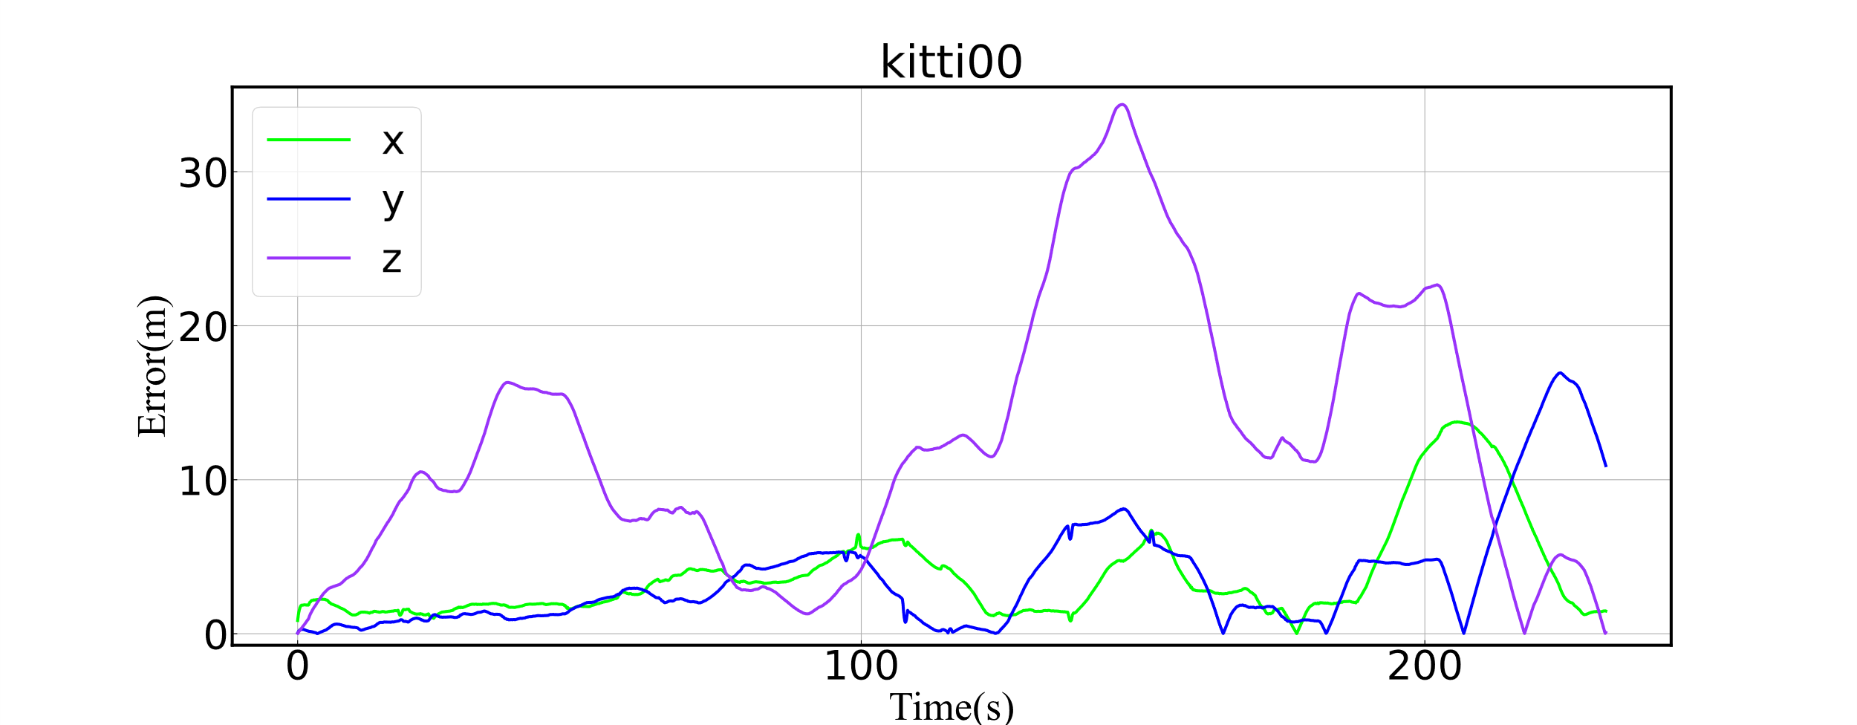
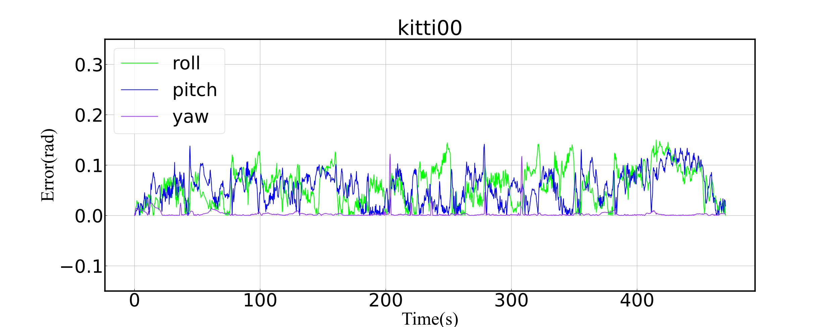
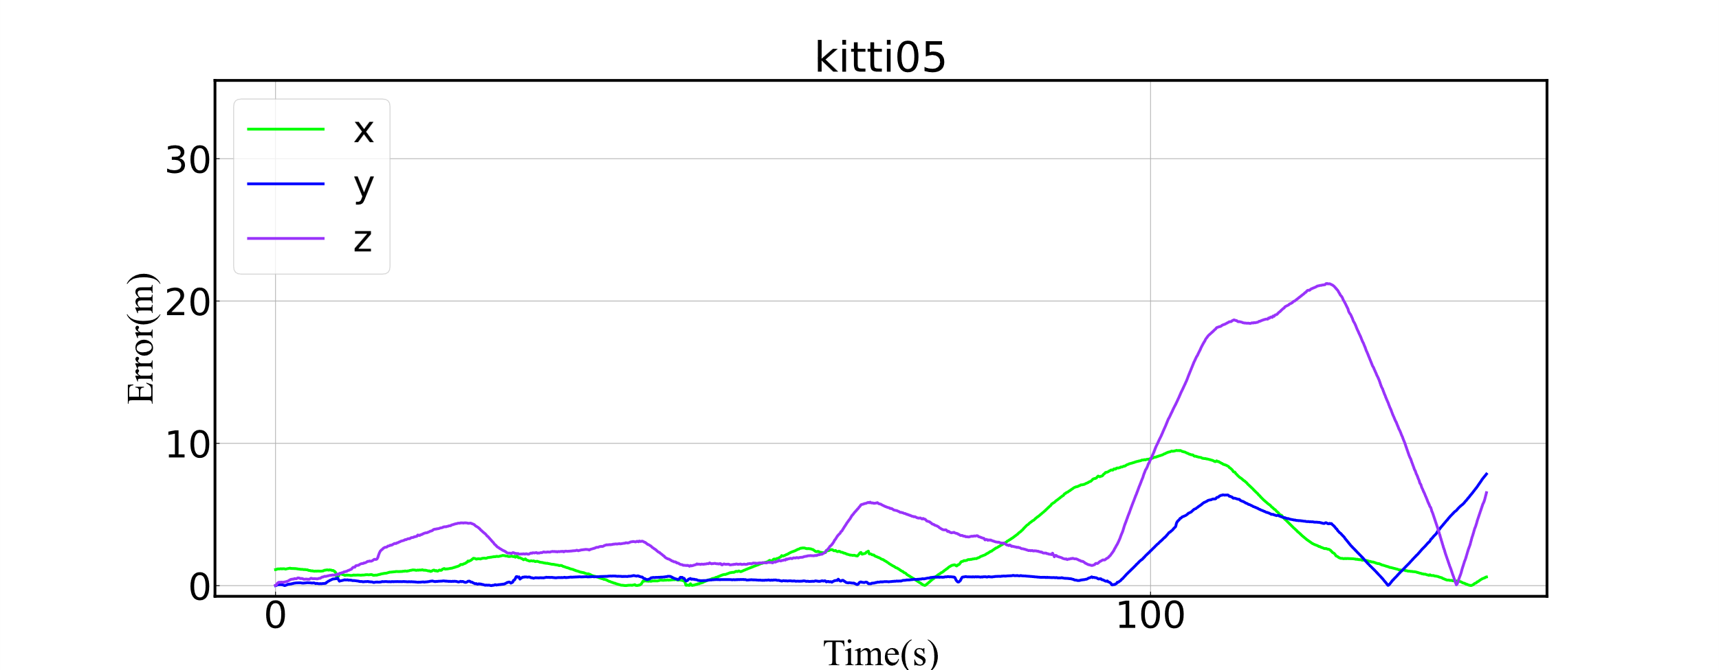
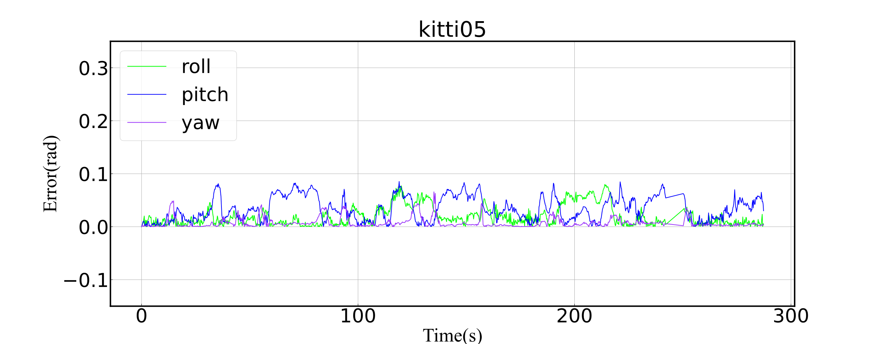
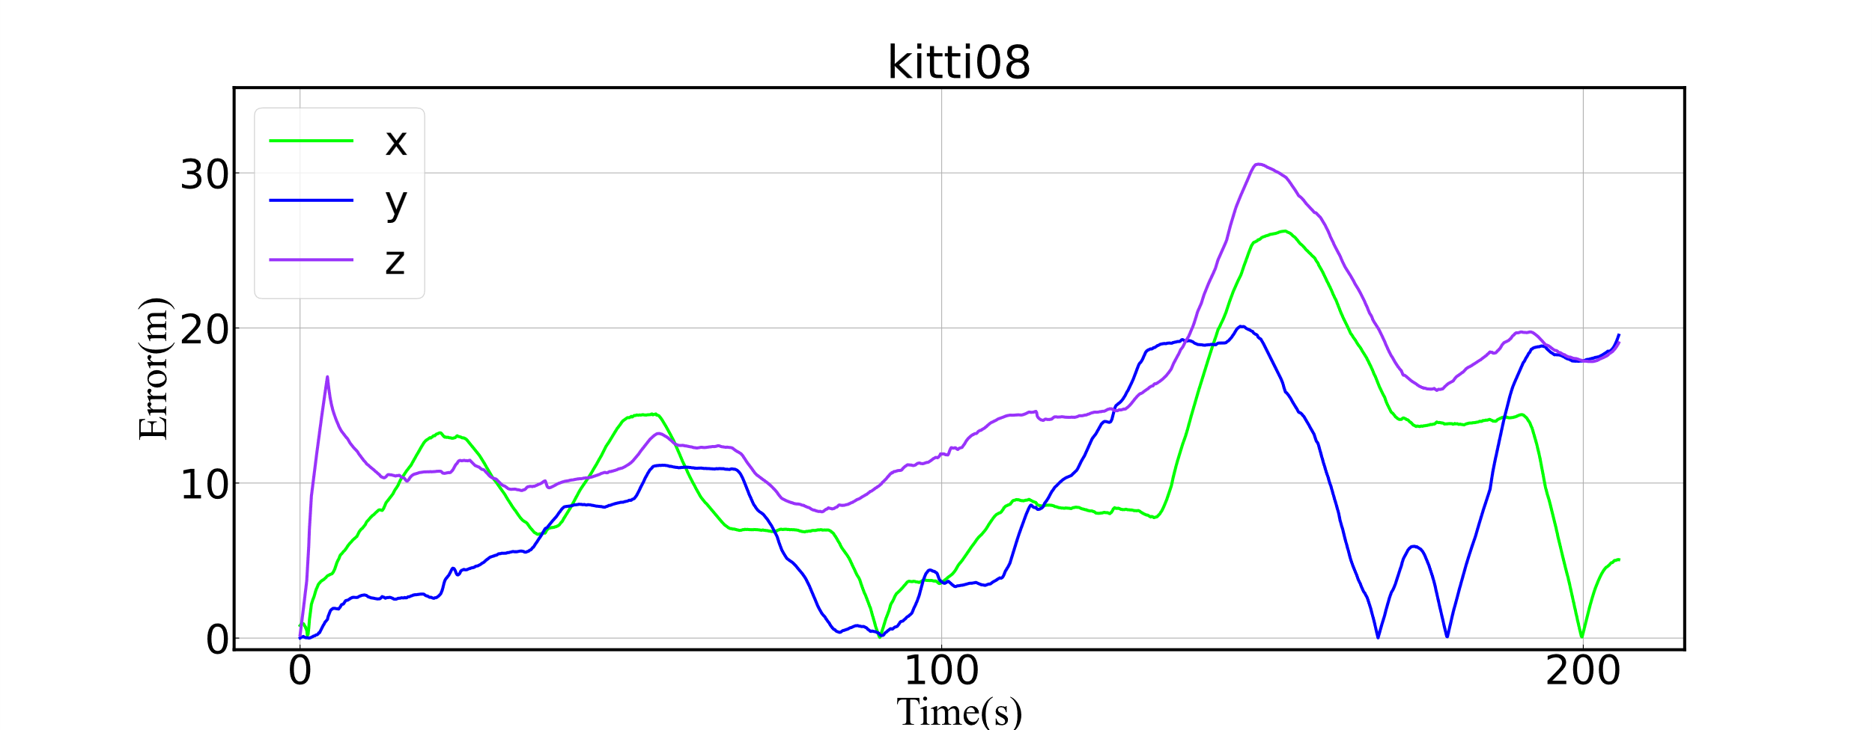
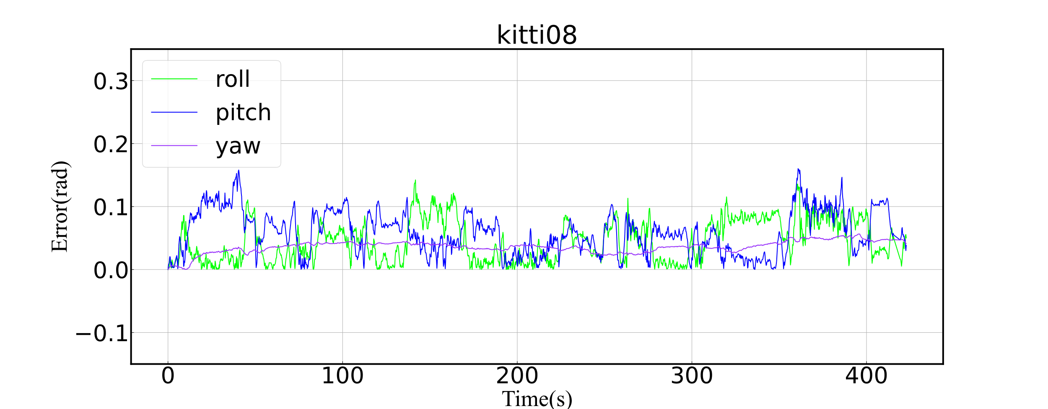
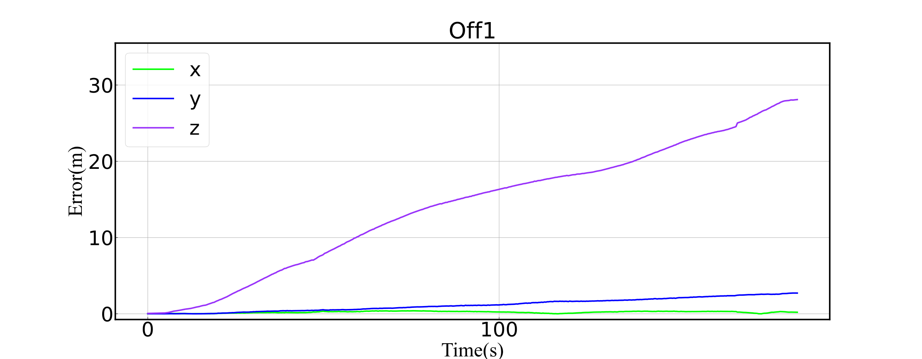
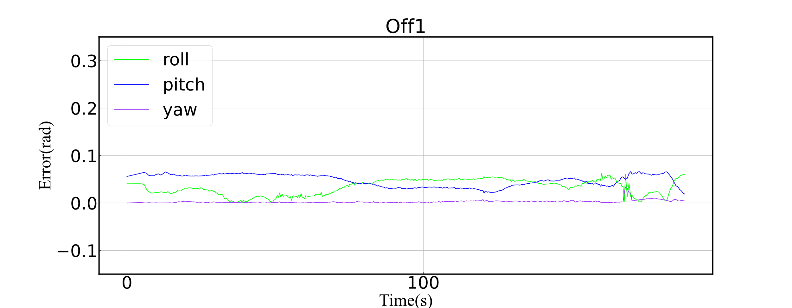
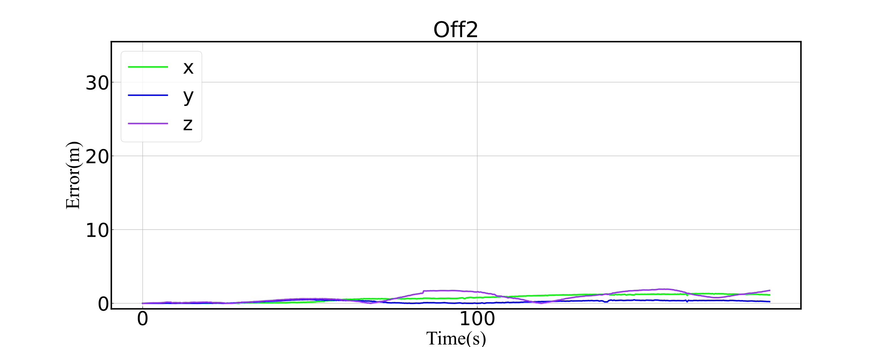
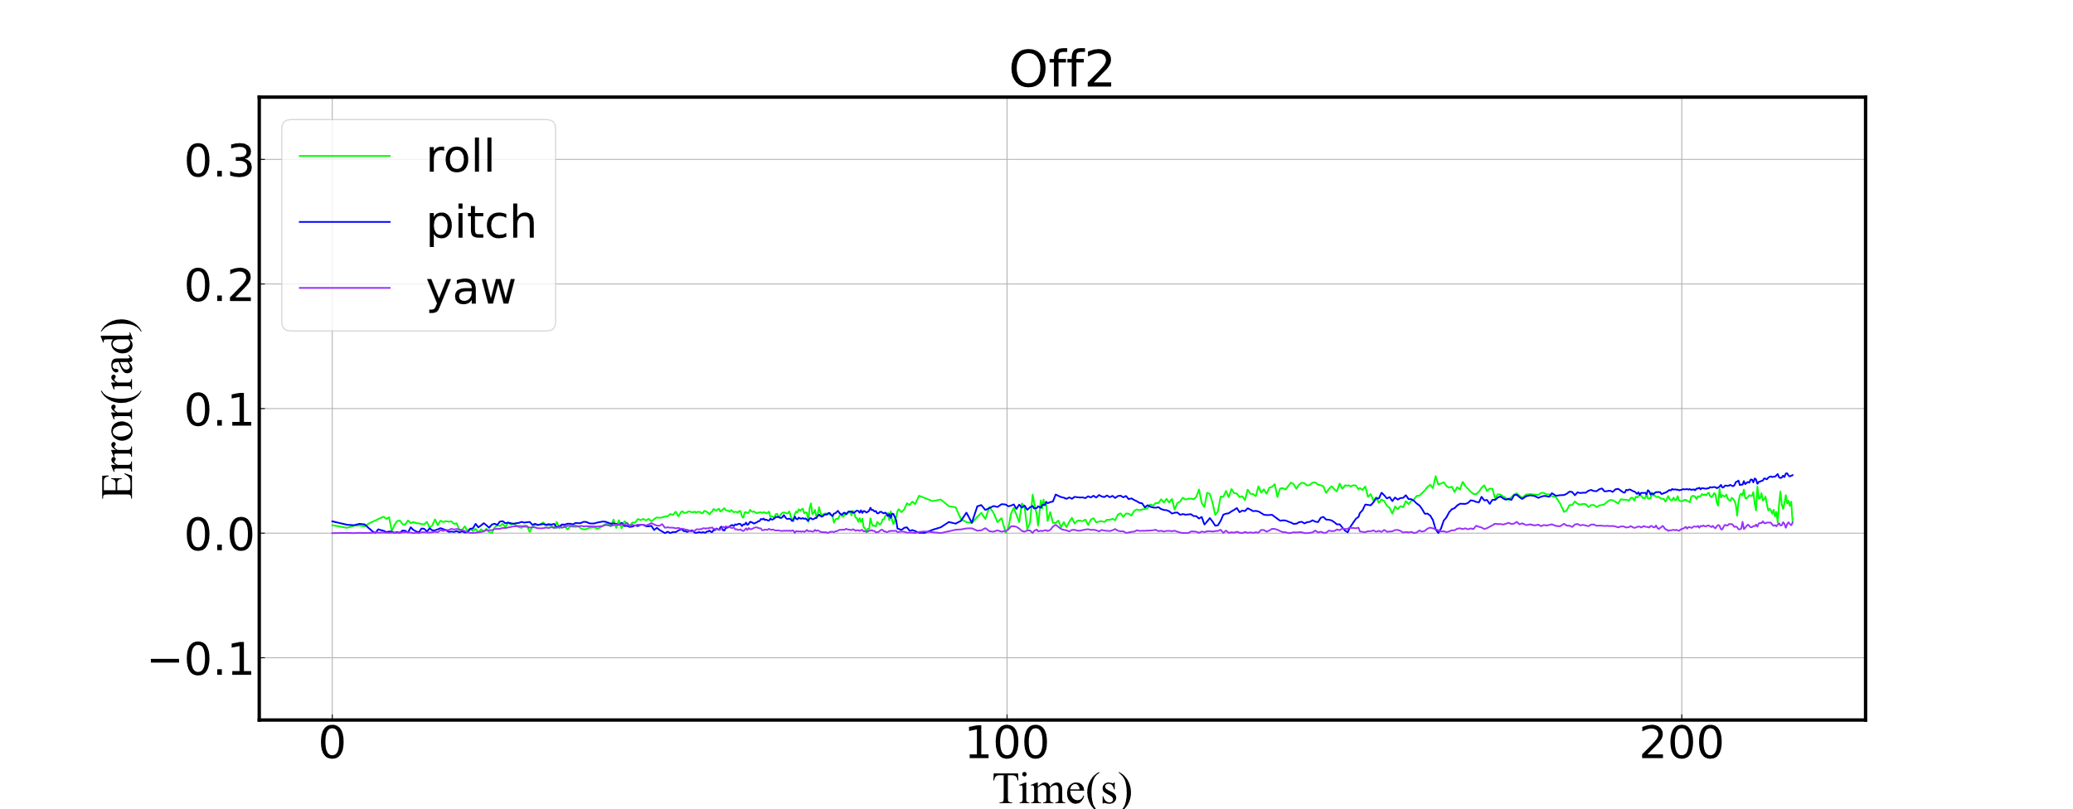
(a)
(b)
(c)
(d)
(e)
(f)
(g)
(h)
(i)
(j)

Slide 6
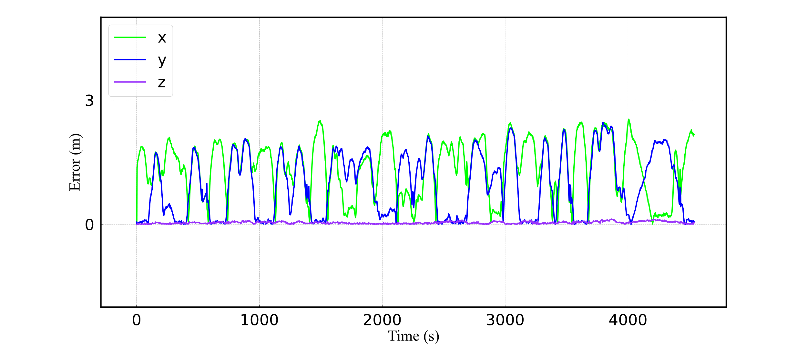
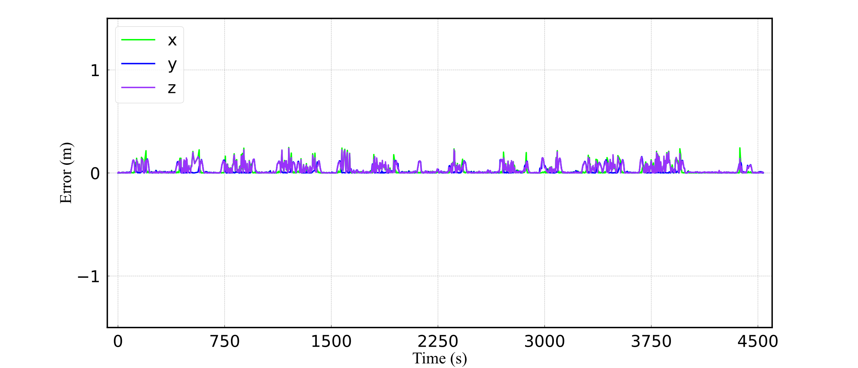
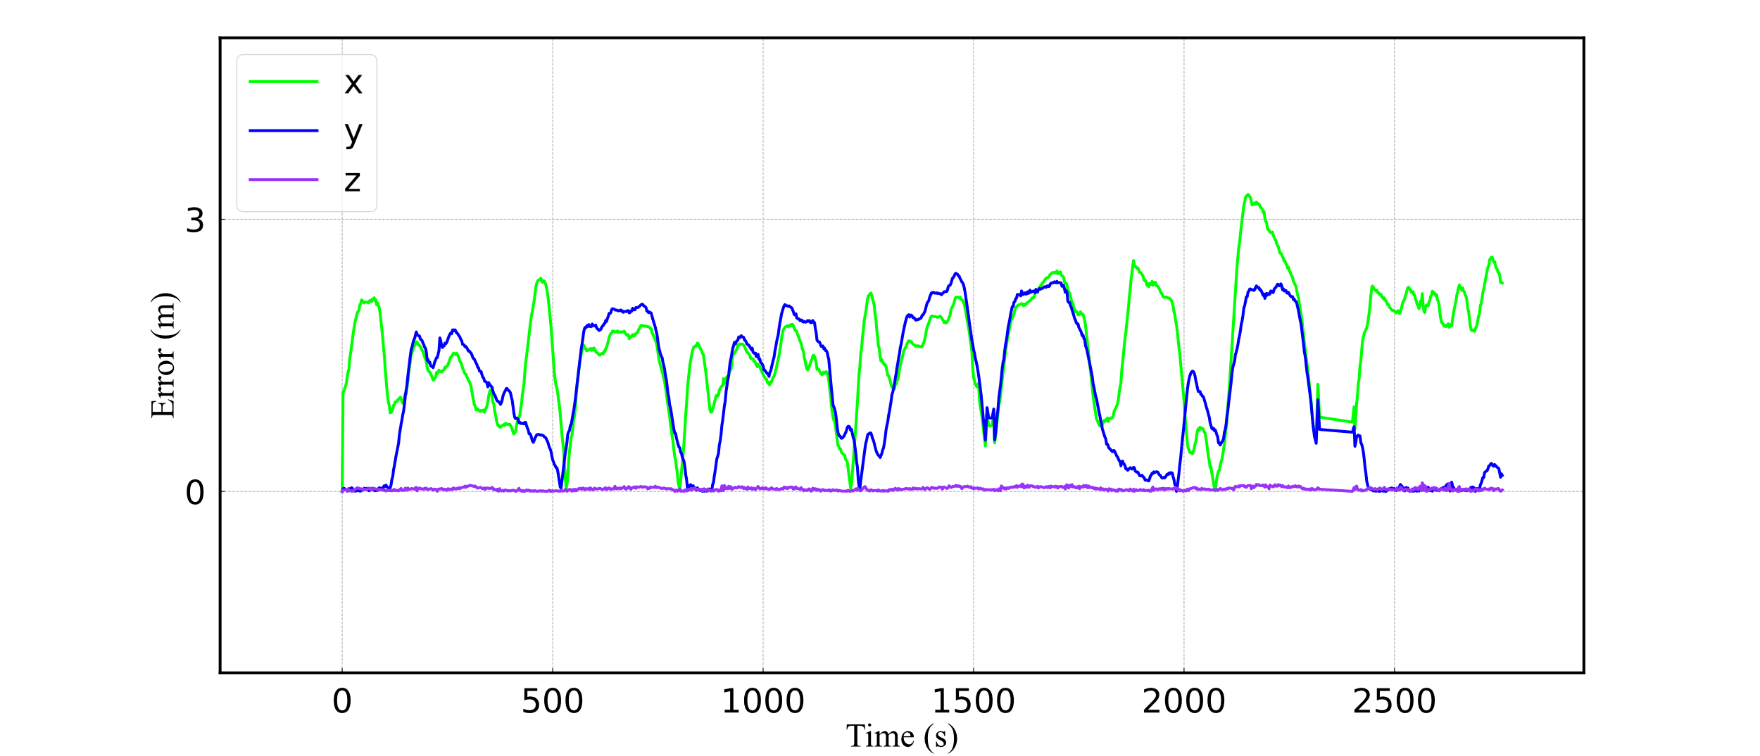
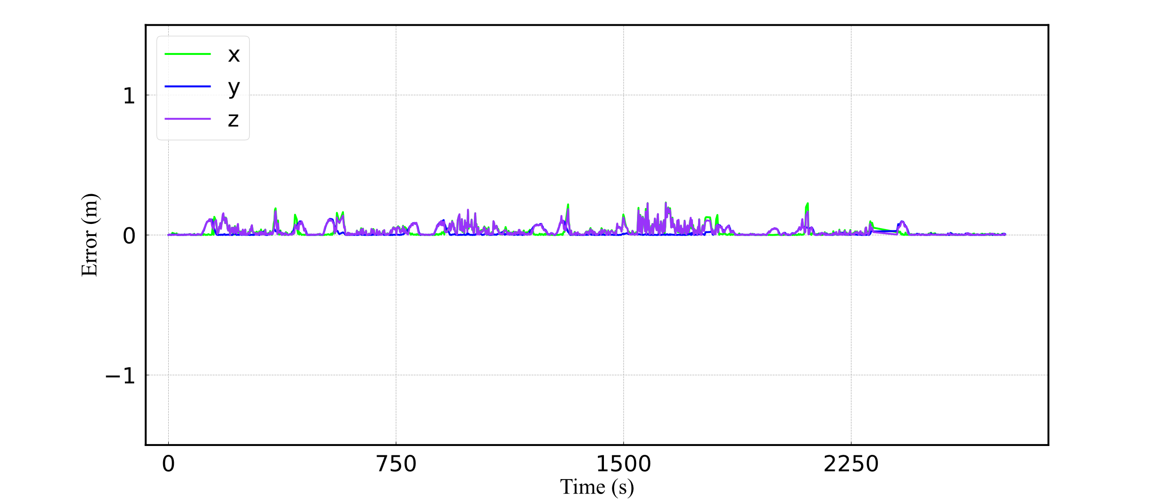
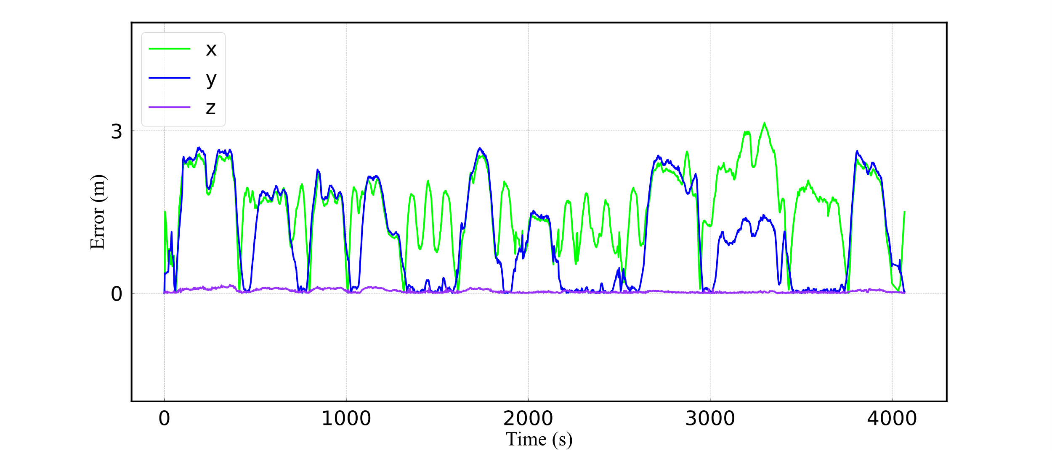
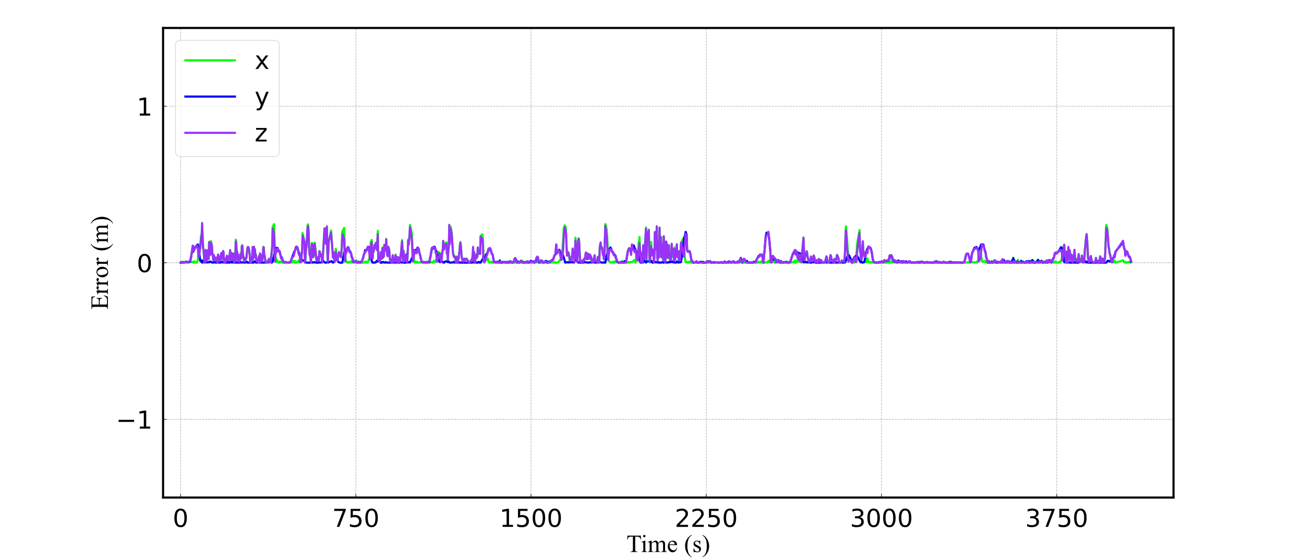
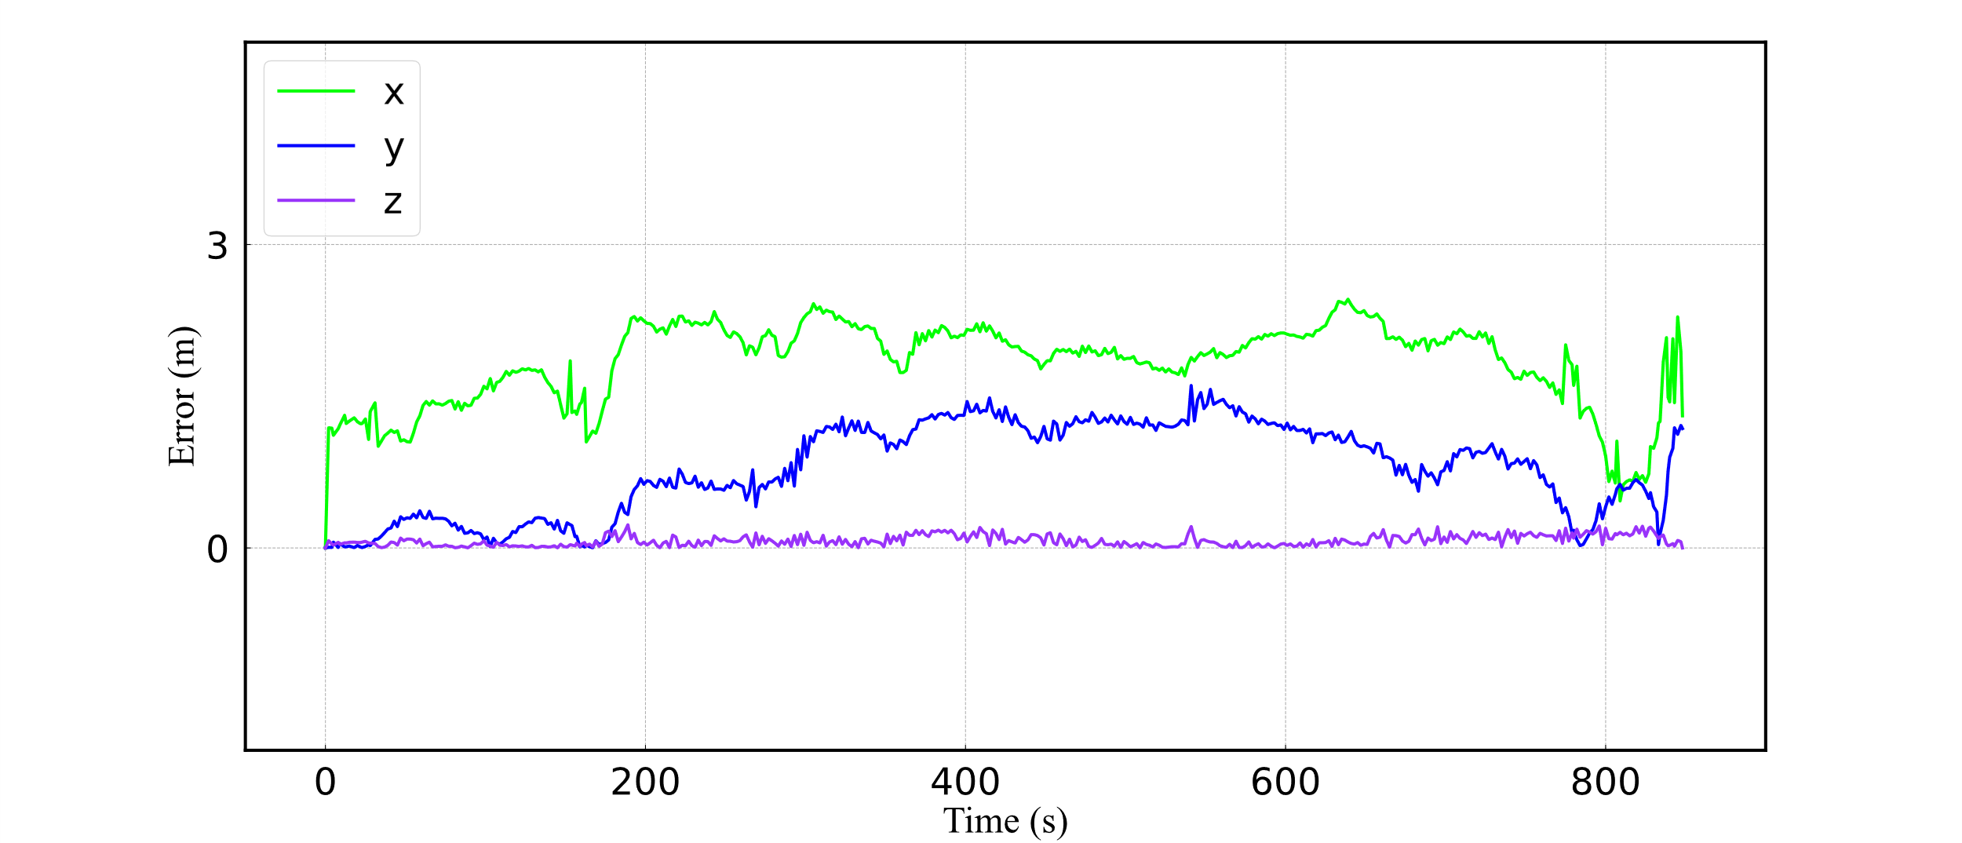
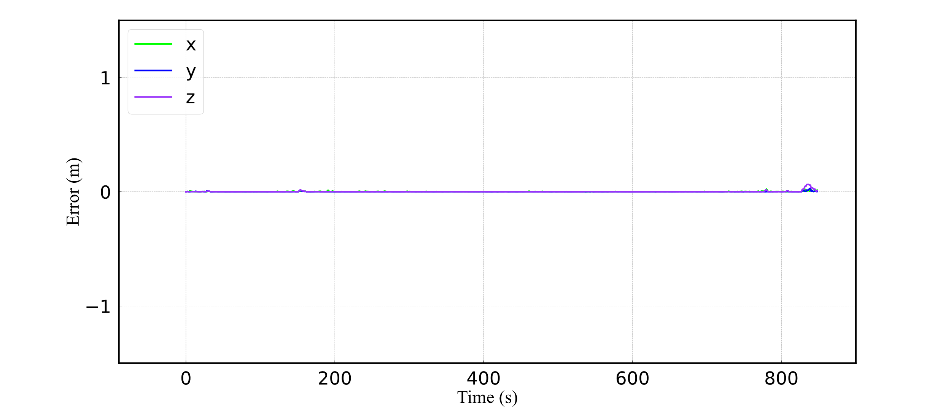
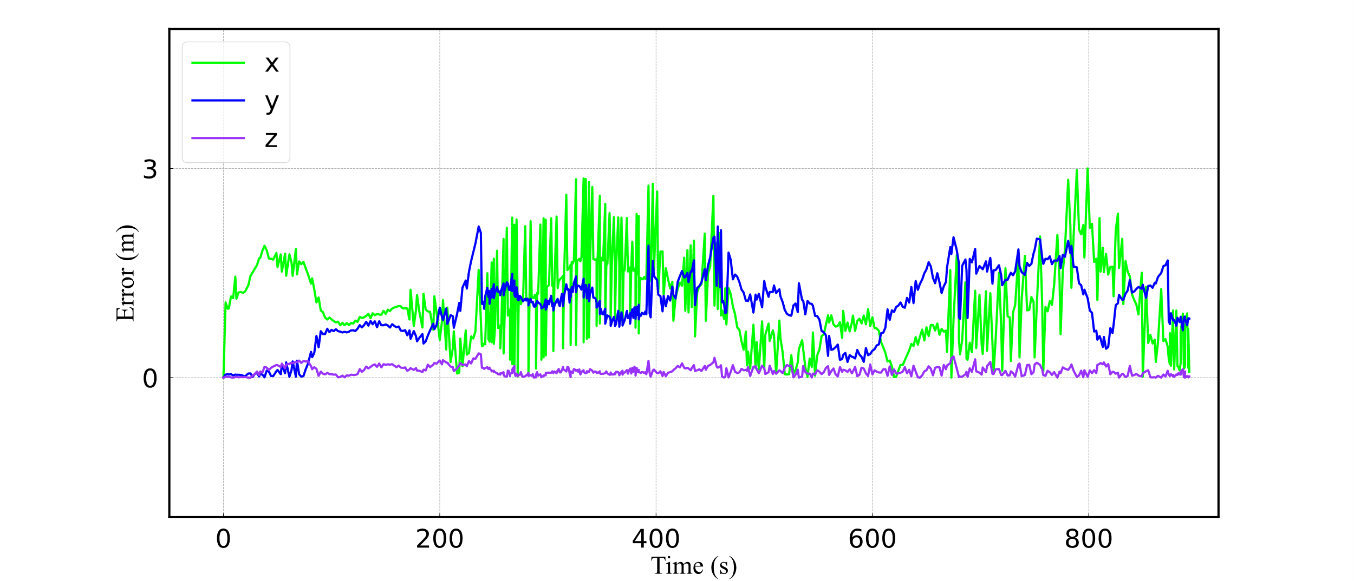
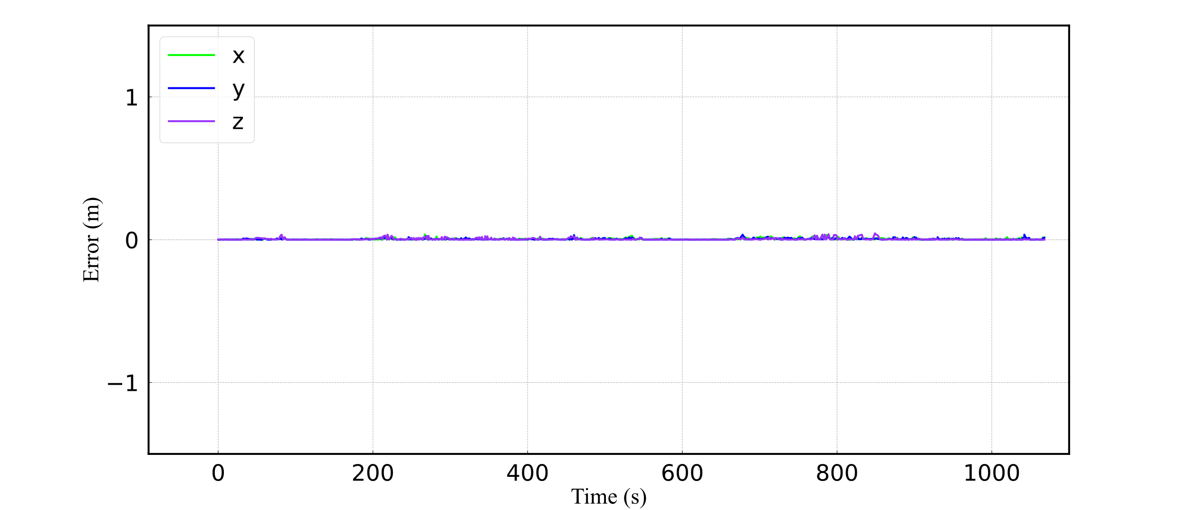
(a) KITTI00
(b) KITTI05
(c) KITTI08
(d)Offroad1
(d)Offroad2

Slide 7
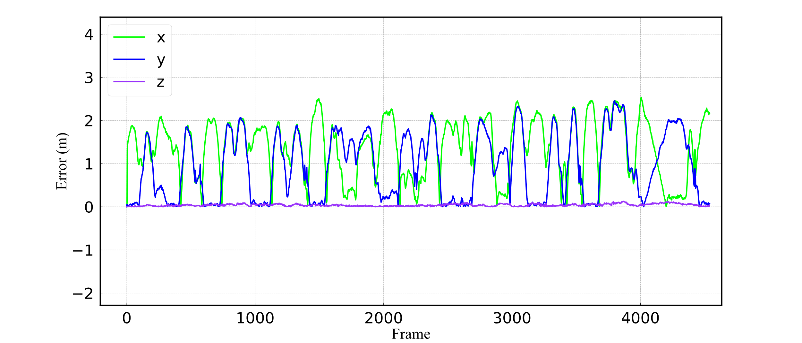
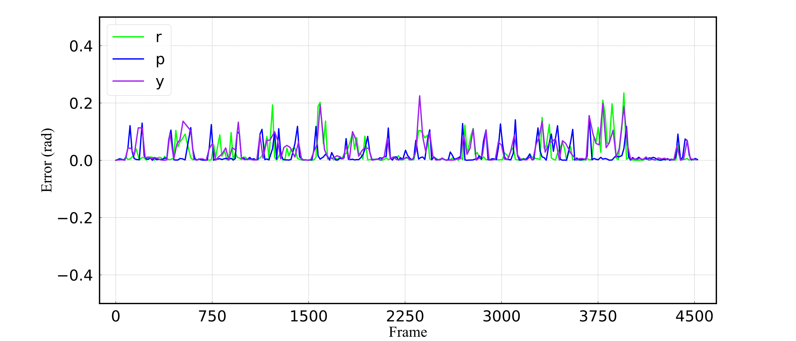
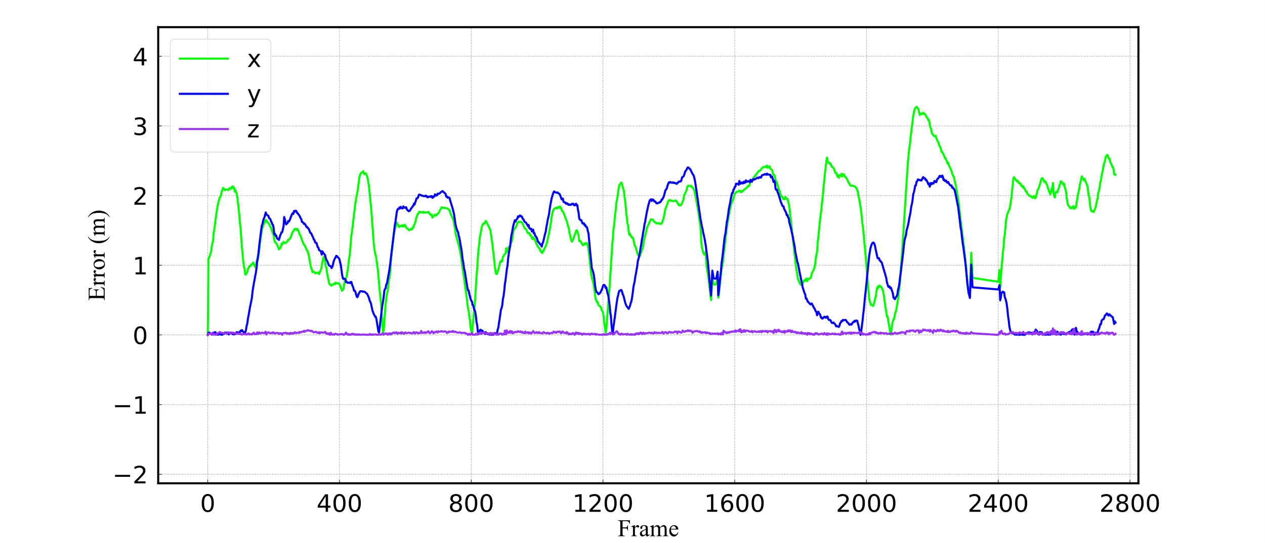
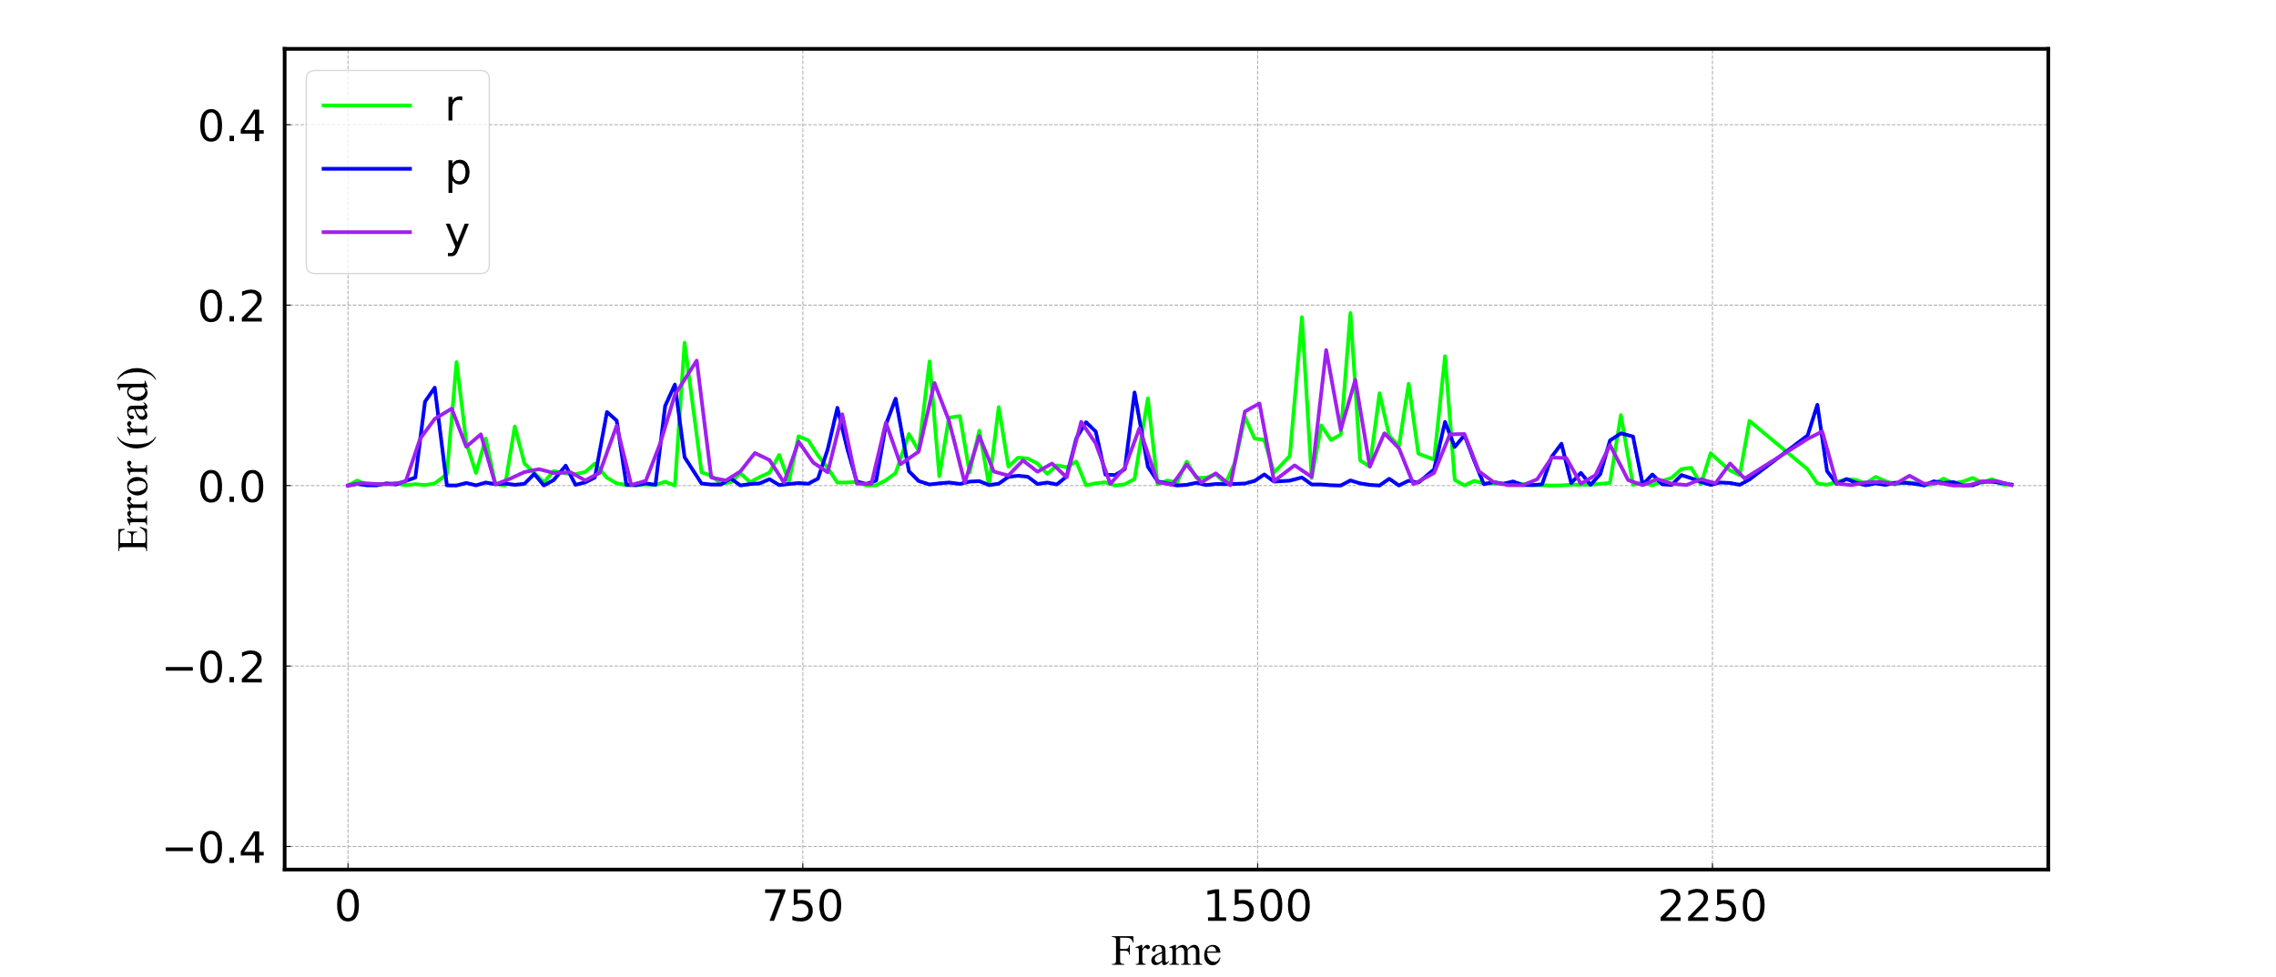
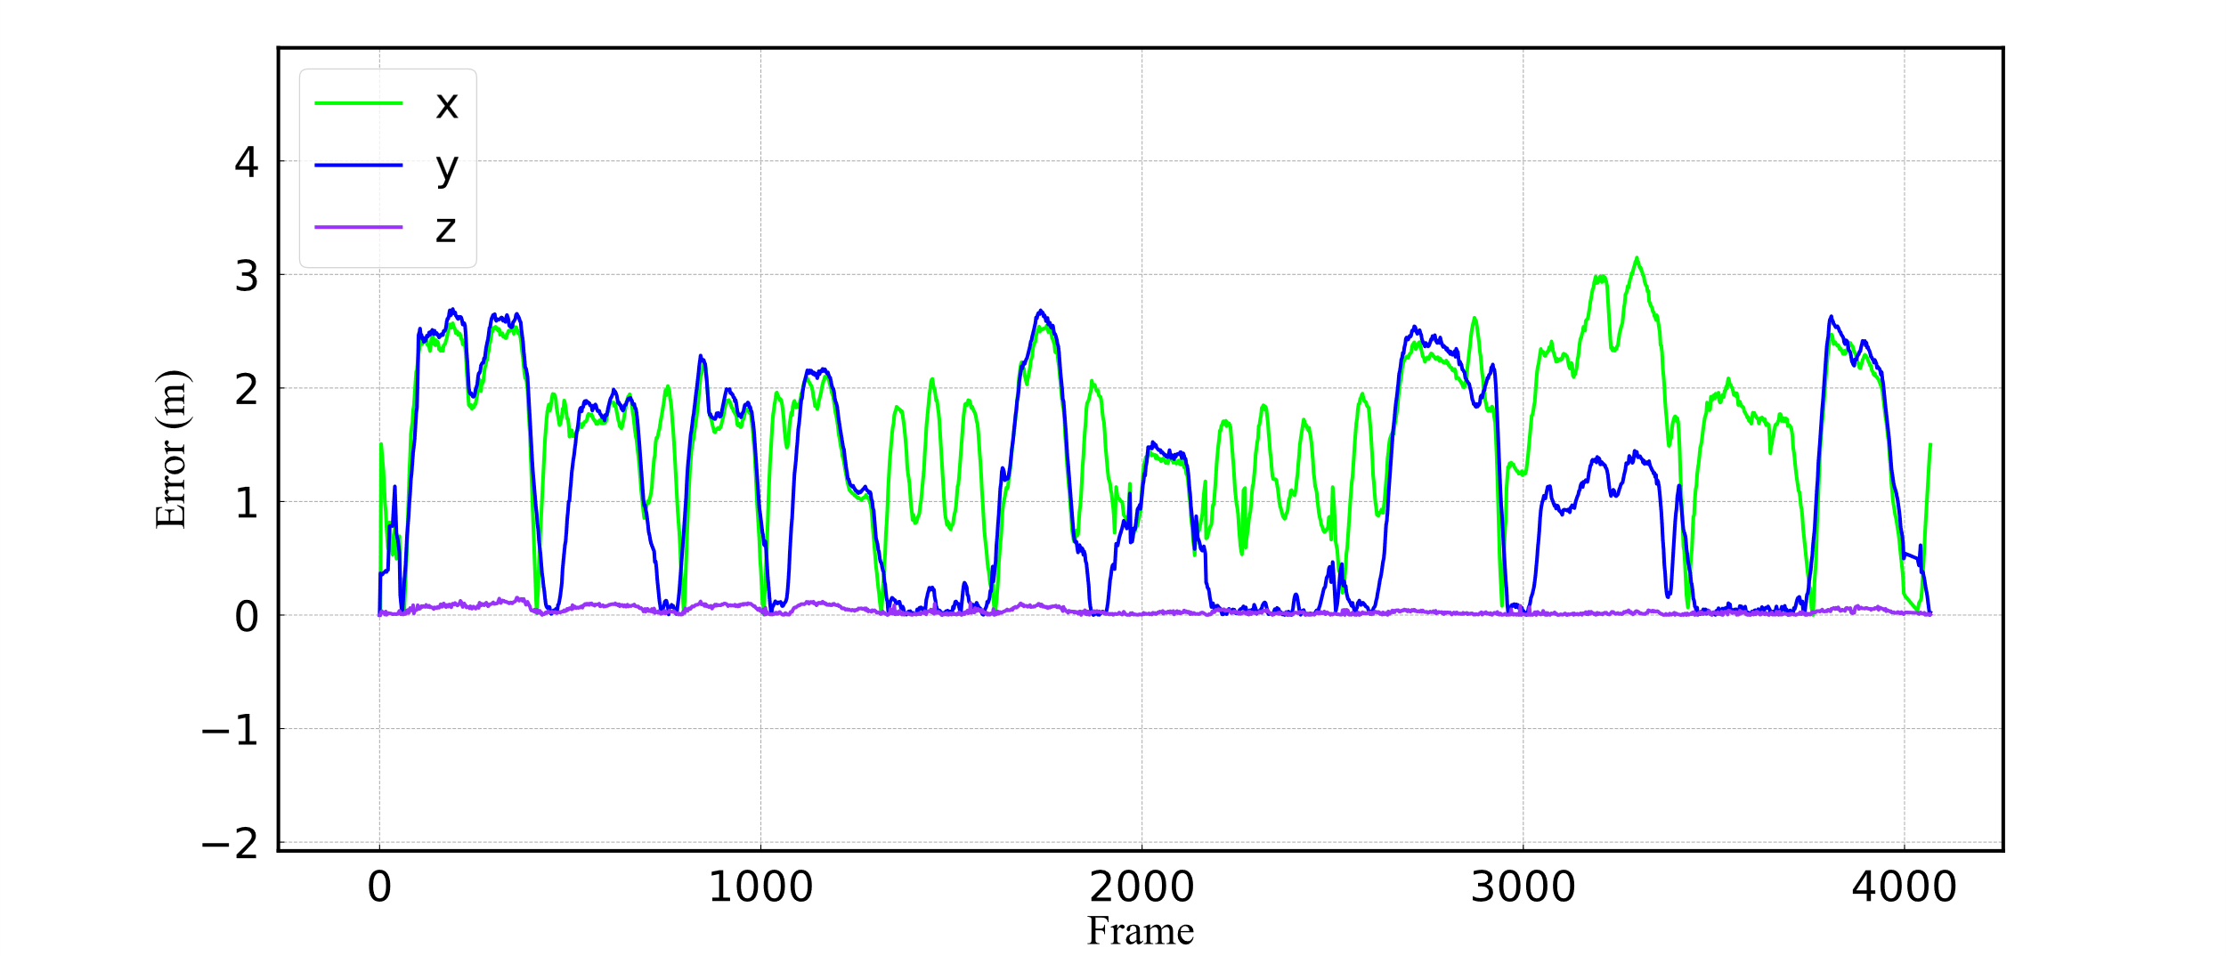
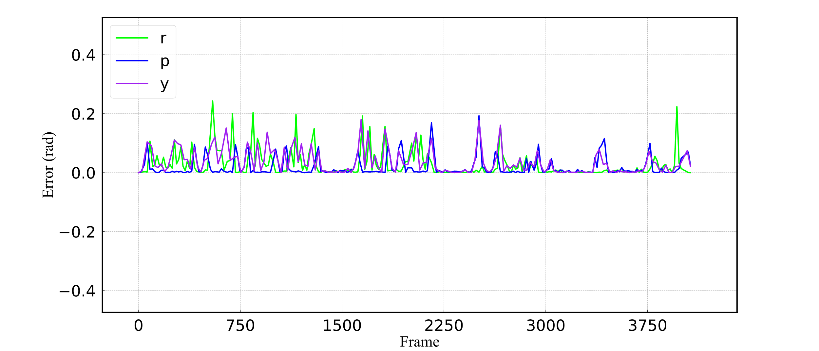
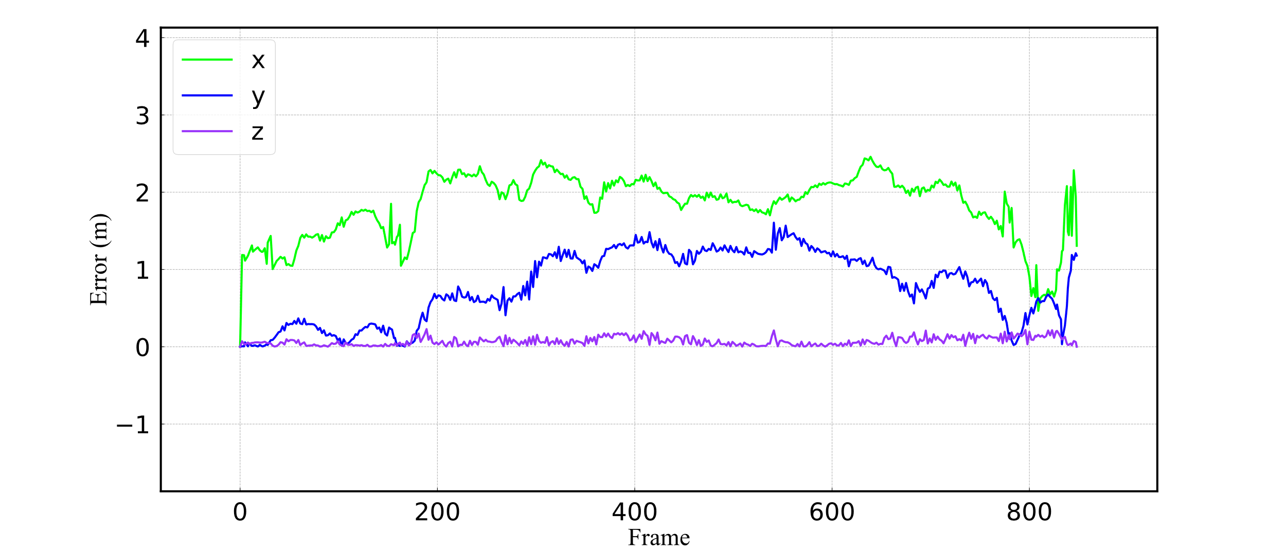
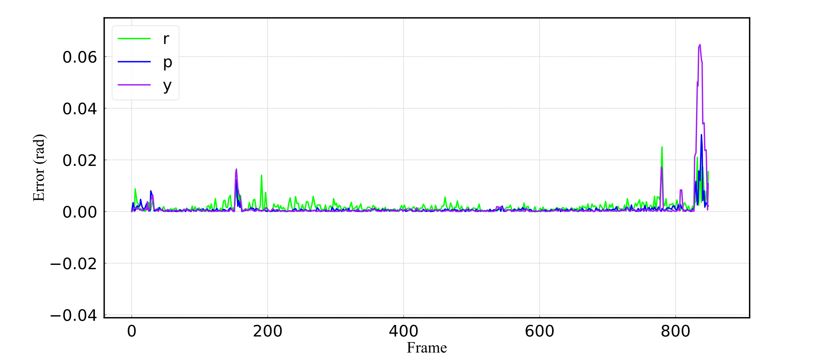
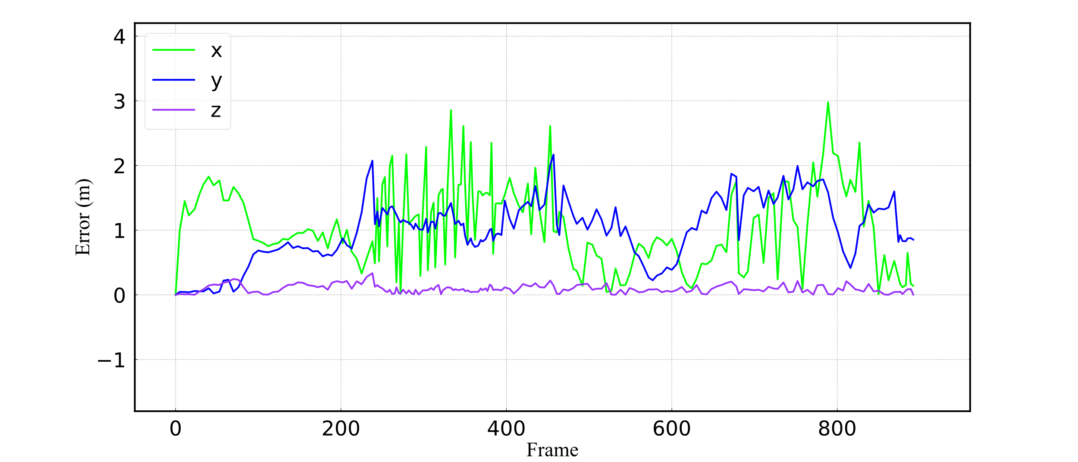
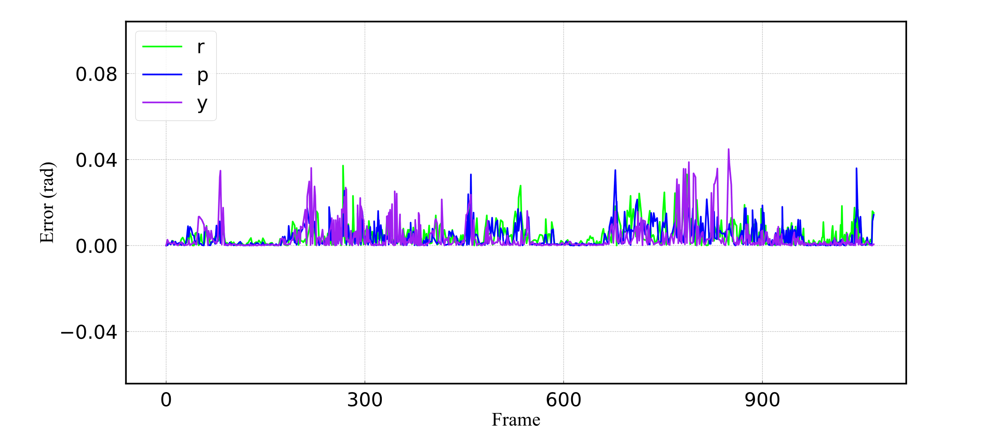
(a) KITTI00
(b) KITTI00
(c) KITTI05
(d) KITTI05
(e) KITTI08
(f) KITTI08
(g) Offroad1
(h) Offroad1
(i) Offroad2
(j) Offroad2

Slide 8
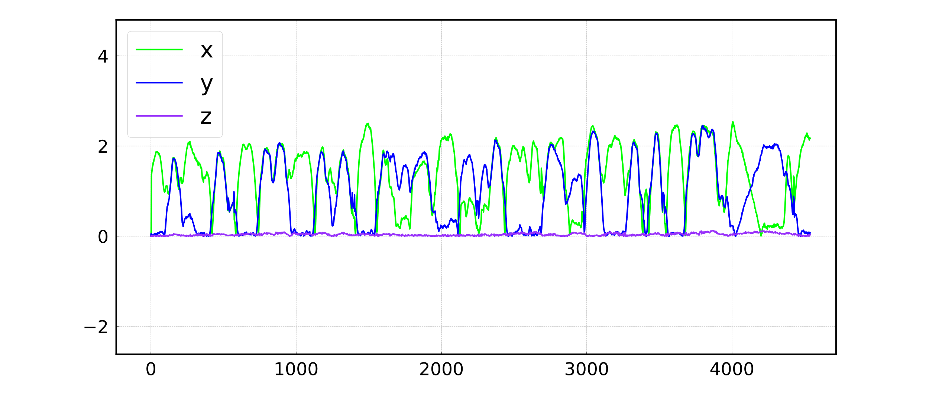
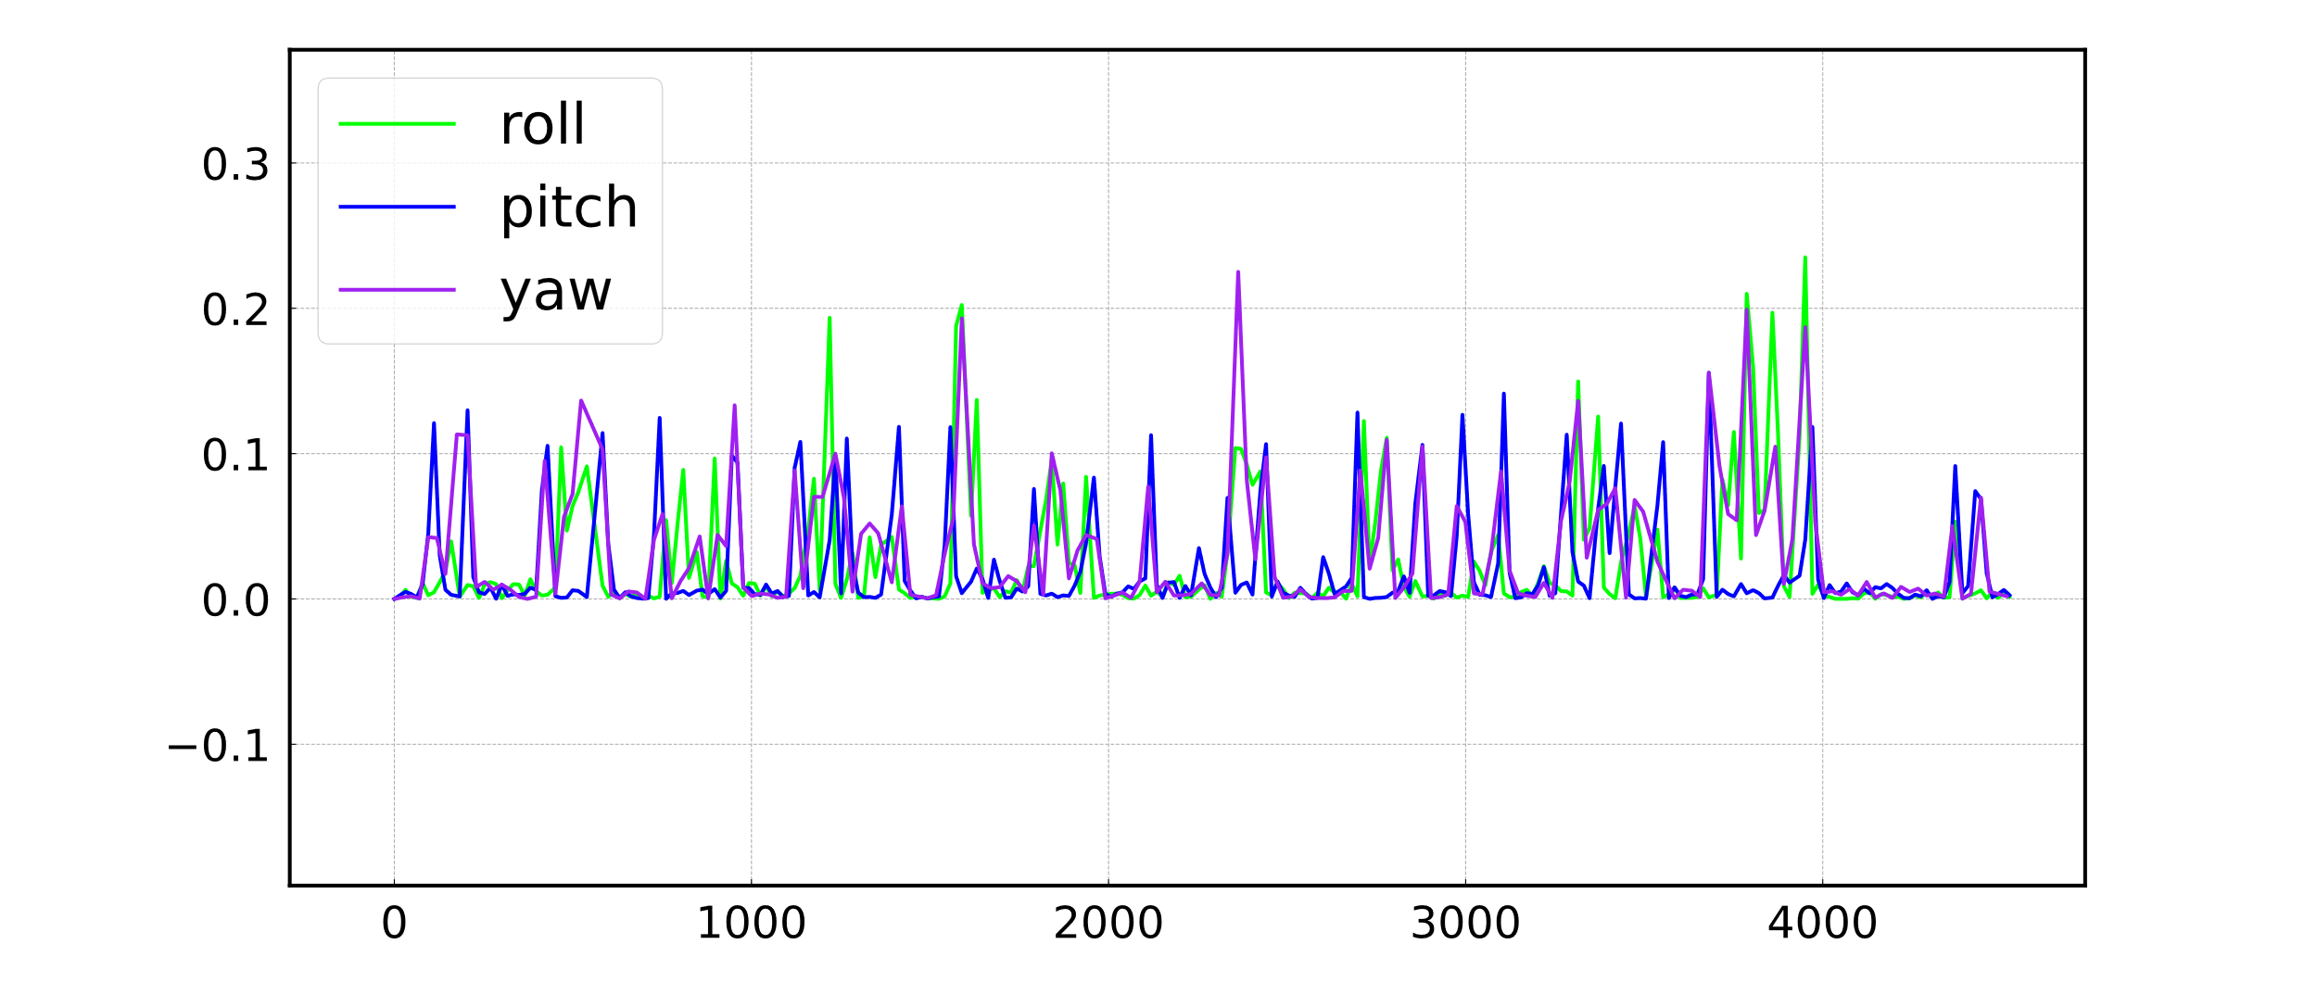
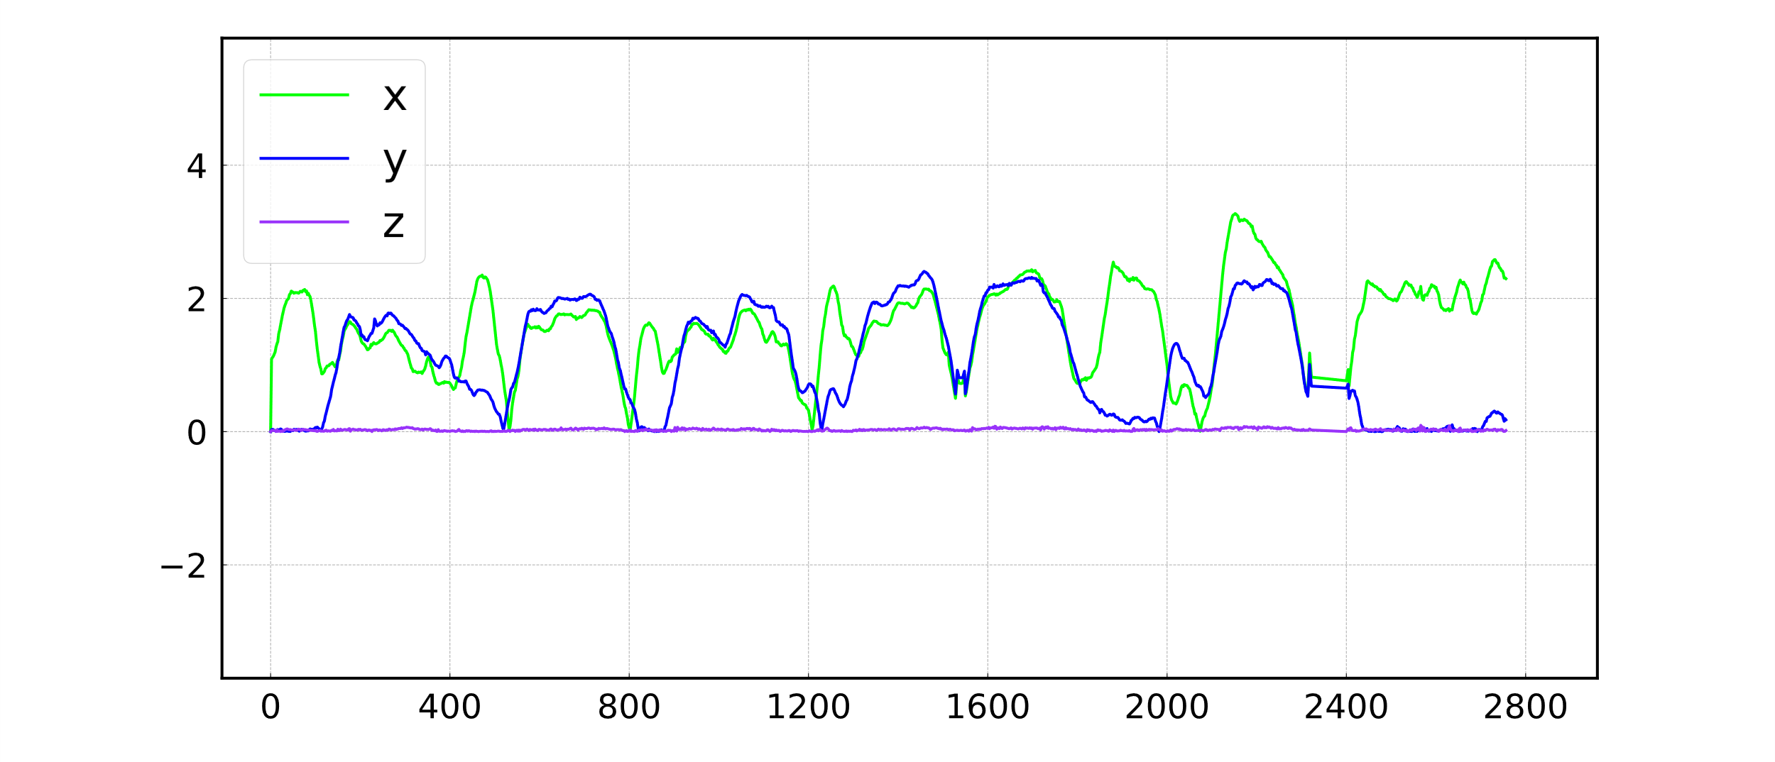









(a) KITTI00
(b) KITTI00
Error (m)
Error (rad)
Frame
Frame
(c) KITTI05
(d) KITTI05
Error (m)
Error (rad)
Frame
Frame
(e) KITTI08
(f) KITTI08
Error (m)
Error (rad)
Frame
Frame
(g) Offroad1
(h) Offroad1
Error (m)
Error (rad)
Frame
Frame
(i) Offroad2
(j) Offroad2
Error (m)
Error (rad)
Frame
Frame
(k) Offroad3
(l) Offroad3
Error (m)
Error (rad)
Frame
Frame

Slide 9




(a) Offroad1 Trajectory
(b) Offroad2 Trajectory
Z (m)
Z (m)
Time (s)
Time (s)
(c) Offroad1 Elevation
(d) Offroad2 Elevation

Slide 10




(a) Qianfoshan Trajectory
(b) Xinglongshan Trajectory
Z (m)
Z (m)
Time (s)
Time (s)
(c) Qianfoshan Elevation
(d) Xinglongshan Elevation

Slide 11






(a) Offroad1 Trajectory
(b) Offroad2 Trajectory
(c) Offroad3 Trajectory
Z (m)
Z (m)
Z (m)
Time (s)
Time (s)
Time (s)
(d) Offroad1 Elevation
(e) Offroad2 Elevation
(f) Offroad3 Elevation

Slide 12












(a) KITTI00
(b) KITTI00
Error (m)
Error (rad)
Data Frame Sequence
Data Frame Sequence
(c) KITTI05
(d) KITTI05
Error (m)
Error (rad)
Data Frame Sequence
Data Frame Sequence
(e) KITTI08
(f) KITTI08
Error (m)
Error (rad)
Data Frame Sequence
Data Frame Sequence
(g) Offroad1
(h) Offroad1
Error (m)
Error (rad)
Data Frame Sequence
Data Frame Sequence
(i) Offroad2
(j) Offroad2
Error (m)
Error (rad)
Data Frame Sequence
Data Frame Sequence
(k) Offroad3
(l) Offroad3
Error (m)
Error (rad)
Data Frame Sequence
Data Frame Sequence

